Slide 1
Don’t Fight, Mediate!
Dispute resolution through dialogue
Finding win-win solutions
Notes:
NOTES TO THE TEACHER
This PowerPoint presentation is an optional aid to run the “Don’t Fight, Mediate!” activity. Most of the information it contains illustrates the various steps outlined in the Student Workbook. It can be used to correct the information gathered by the students.
The proposed exercises are ready-to-use suggestions to run the activity and encourage your students’ participation.​
The notes section of several slides include “NOTES FOR THE TEACHER," which provide specific information for the activity.​
© Éducaloi, 2024​

Slide 2
Period 1:
Preparing for Mediation
• Presenting the Activity
• Scenario and Discussion
• Discovering Alternative Dispute Resolution (ADR) Methods and Mediation (information gathering)
• Introducing the Players in Mediation
• The Mediation Process
Period 2:
Mediation Day!
• Team Preparation
• Mediation Session
• Presenting the Solutions
Period 3 (optional): Evaluation

Slide 3
Scenario
Notes:
SCENARIO
Read the scenario in the Student Workbook with the students:
Christine really wants to go on a school trip to Europe with her friends. But her parents can’t afford to pay for it. To raise money, she’s been working for several months as a clerk in a grocery store in her neighbourhood. She has always gotten along well with her co-worker, Simon, whose antics usually make Christine smile.
One Monday evening, Simon decides to play trick on Christine and films her with his cell phone. While they’re placing items on shelves, he rolls a can of peas behind her. Not seeing the can, Christine backs up and steps on it, falling backwards and knocking several items to the floor. She has a hard time getting up and is furious with Simon who’s laughing at her. He’s feeling proud of himself for having recorded the whole thing and knows he’ll make his friends laugh when they see the footage. Christine sees Simon’s cell phone and asks him to delete the video immediately. He pretends to delete it, then quickly puts his cell phone away.
When she arrives at school the next day, a friend of Christine’s says: “Watch where you step, there might be a can of peas in the way, hahaha!” Christine realizes that Simon has shared the video with other students. During the day, when she passes Simon’s friends, they pretend to fall and burst out laughing. Even though she’s very angry with Simon, she decides not to report him to her employer.
Instead, she decides to get back at him in an underhanded way. She writes negative comments online about the fast-food place near the school that is run by Simon’s parents:
“The employees never wash their hands. I even saw an employee wipe his nose and continue preparing the hotdogs.”
“Several students told me they were sick after eating a burger. They’re serving us rotten meat—it’s disgusting!”
“Even their son doesn’t want to work there. He works at the local grocery store.”
Christine’s comments convince many students to stop eating at the restaurant. Simon’s parents notice a big drop in their student customers.
Christine and Simon have stopped talking to each other since these events. The situation is very tense at work. They say bad things about each other to the other employees.
Their parents want to find a solution so that their children can keep their jobs at the grocery store and to resolve the situation at the restaurant. Above all, they want their children to reach an agreement at work before the manager at the grocery store notices the situation and intervenes. They decide to seek outside help to find a solution that will work for everyone.

Slide 4
Information Gathering: ADR Methods
Notes:
NOTES TO THE TEACHER
Discovering alternative dispute resolution methods
Ask the students to search Éducaloi’s website for “Resolving a Conflict: Negotiation, Mediation, Conciliation and Arbitration” to answer questions 1 and 2 in the Student Workbook:
What types of justice or ADR methods exist?
Answer: Negotiation, mediation, conciliation and arbitration.
In your opinion, which ADR method would be the most appropriate for resolving the conflict in the scenario? Explain why.
Possible answer: Mediation would be the most appropriate because the people involved can propose and choose the best solution to the conflict on their own. In the event of a problem, the mediator is there to ensure that the mediation process runs smoothly.
Note that all of the resolution methods mentioned above could be appropriate depending on the state of the relationship between the parties involved in the conflict.

Slide 5
Alternative Dispute Resolution Methods
Negotiation: Discussion with the other person to reach an agreement. You’re free to choose how to proceed: the law doesn’t impose any rules for this ADR method.
Mediation: Type of negotiation where a neutral person intervenes to facilitate the discussion. The mediator can propose solutions and draft a proposed agreement.
Conciliation: Type of negotiation where a person facilitates communication between the people who are in conflict. The conciliator generally plays a less active role and does not propose any solutions.
Arbitration: Confidential ADR method in which an arbitrator rules on the conflict and decides who’s entitled to what. The arbitration process is more flexible than a court case.
Notes:
NOTES TO THE TEACHER
This slide is used to correct the resolution methods with the students. It provides examples of their main characteristics.
Ask the students which method would be the most appropriate to resolve the conflict in the scenario while explaining their choice.
Possible answers: The best method would be mediation since the people in conflict can develop their own solution(s) with guidance of a mediator.
Arbitration is used more often when the parties do not agree and have difficulty communicating.

Slide 6
Information Gathering: Discovering Mediation
Notes:
NOTES TO THE TEACHER
Discover what mediation is all about!
Ask the students to search Éducaloi’s website “Resolving a Conflict: Negotiation, Mediation, Conciliation and Arbitration” and the playlist for “Mediation: Resolve Conflicts Without Going to Court” on YouTube to answer questions 3 to 7 in the Student Workbook.
The next slides will help you review the important elements of mediation and correct the students’ answers.

Slide 7
Discovering Mediation
Notes:
NOTES TO THE TEACHER
Watch the video if the students have not taken the time to watch it.
Correct Question 3 in the Student Workbook:
What’s the goal of mediation?
Possible answer: To find a solution that satisfies everyone.
What are the advantages of mediation compared to going to court?
Possible answer: Quicker, confidential and sometimes free.

Slide 8
Mediation: A Method to Resolve Conflicts
OBJECTIVES
Encourage the people in conflict to discuss their problem and find a solution.
Propose several possible solutions to find one that satisfies everyone.

Slide 9
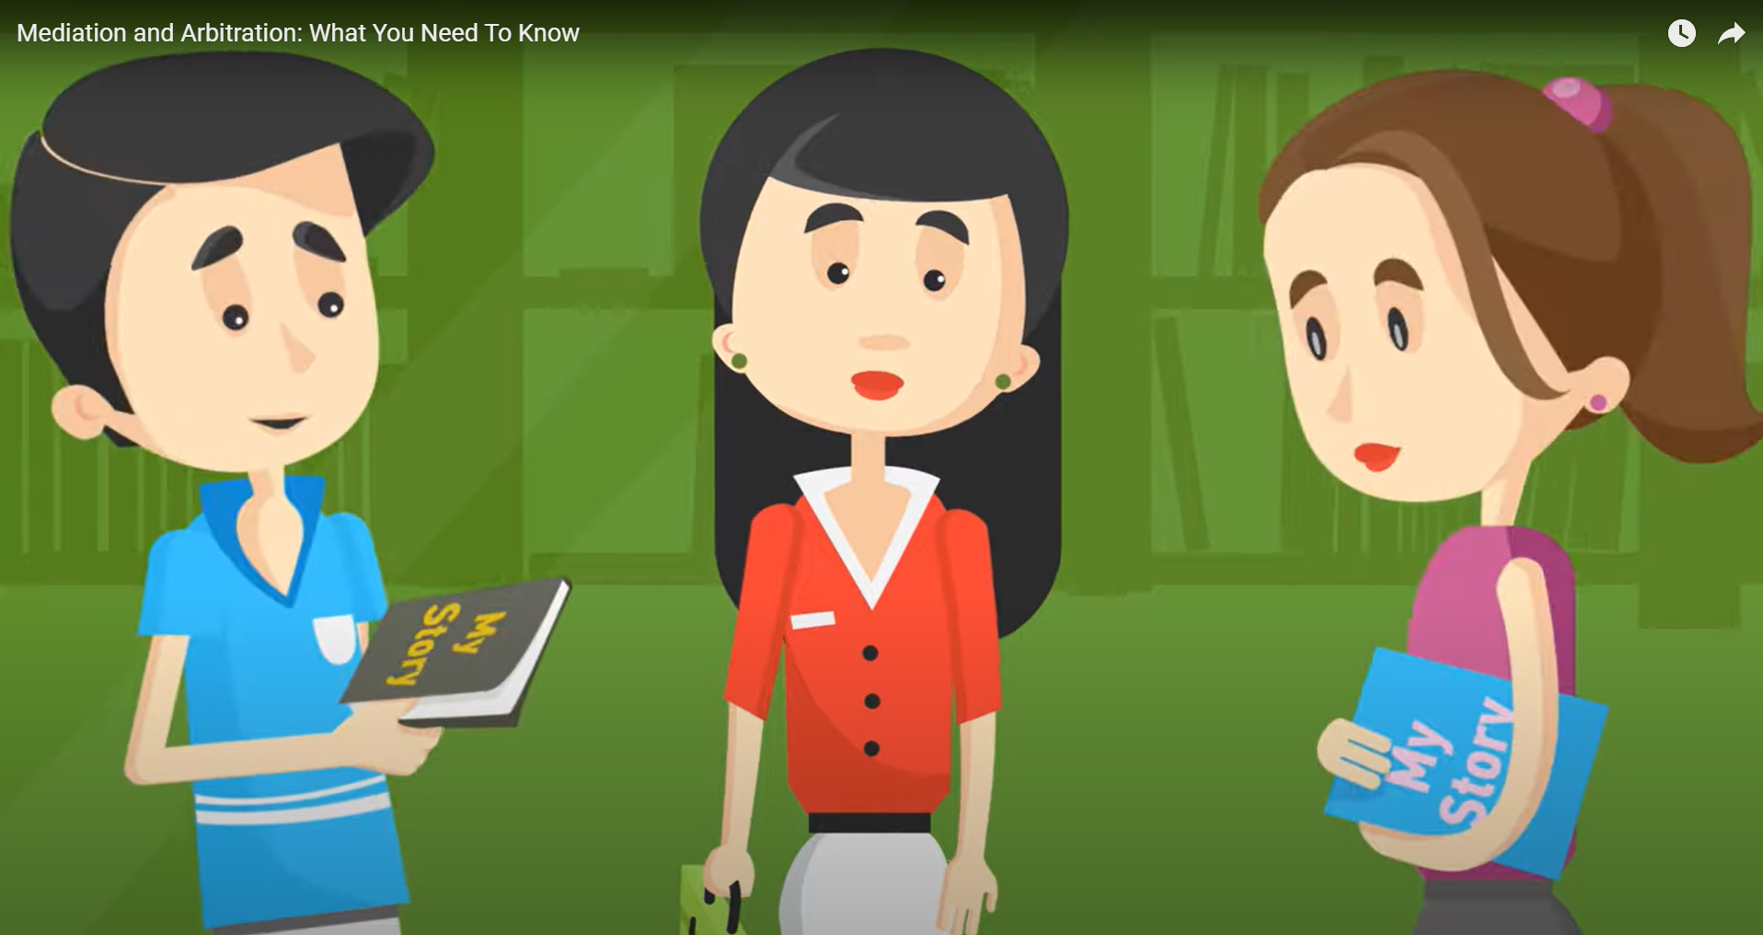
Who Is the Mediator?
Mediation and Arbitration: What You Need To Know - YouTube
Notes:
NOTES TO THE TEACHER
Watch the video.
Correct Question 4 in the Student Workbook:
What is the mediator’s role?
Answer: To assist the opposite parties in negotiating the resolution outside of court. In other words, to encourage discussion between the sides to find solutions that work for everyone.
What is the role of the people in conflict during the mediation?
Answer: To tell their side of the story, formulate their expectations and suggest possible solutions.
True or false? The mediator gives legal advice or opinions.
Answer: False. The mediator guides the conversation between the sides. They may speak with each party about their cases, but will never give legal advice or opinions. They must remain neutral and fair.

Slide 10
Who Is the Mediator?
The mediator is a person chosen by the parties to facilitate discussions during mediation.
The mediator is not involved in the conflict.
The mediator is:
Neutral (not influenced by their personal convictions)
Impartial (does not favour one side over the other during mediation)

Slide 11
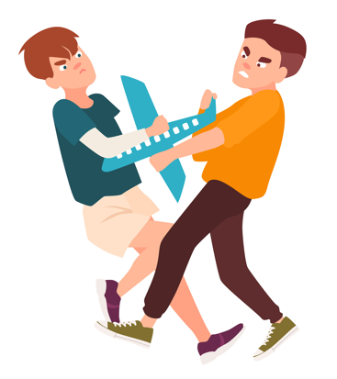
Situations for Mediation
In what circumstances can mediation be useful?
Notes:
NOTES TO THE TEACHER
Identify situations where mediation can be useful.
Invite the students to talk about conflicts they’ve had or heard about.
Discussion point: Mediation can be useful in many situations where at least two people are in conflict.
Correct Question 5 in the Student Workbook and write down examples of situations:
When students have a conflict at school.
When two people have different beliefs, values, opinions or cultures.
When parents separate.
When two companies disagree about what a contract means.
When two people want to avoid a long, expensive court case.

Slide 12
This Is NOT Mediation!
What situations are not mediation?
Notes:
NOTES TO THE TEACHER
Think of situations that are not mediation
Ask the students to differentiate what is and is not mediation.
Correct Question 6 in the Student Workbook:
True or false: The characteristics of mediation:
The outcome is usually win-win or lose-lose. False
Only one solution is possible. False
The people involved find their own solution. True
The mediator can impose a solution. False
The mediator is neutral and impartial. True
Additional discussion points:
Characteristics of mediation
The mediator is neutral and impartial.
The people in conflict find their own solution.
The outcome is usually win-win.
Any solution is possible as long as it satisfies the people in conflict.
Characteristics of what IS NOT mediation
One person influences the discussions or solutions or favours one person’s opinions or solutions.
One person imposes a solution (e.g., arbitrator or judge).
The outcome is usually win-lose or lose-lose.
Only one solution is possible (e.g., applying a law or regulation).

Slide 13
The Advantages of Mediation
What are the advantages of resolving conflicts through mediation?
Notes:
NOTES TO THE TEACHER
Find the advantages of resolving conflicts through mediation.
Correct Question 7 in the Student Workbook on the advantages of mediation.
For the people involved, what are the advantages of resolving their conflict through mediation?
They find a solution for themselves.
They find a solution that satisfies everyone.
They resolve the conflict quickly (instead of dragging it out in court, for example).
Their discussions and agreements are confidential.

Slide 14
Introducing the Players in Mediation

Slide 15
The Players in Mediation
Mediator
People involved in the conflict:
The Goodeats Family
People involved in the conflict:
The Clark Family
Advisor
Advisor
Click here once all the players have been identified..
Expert
Notes:
NOTES TO THE TEACHER
Tips for leading the activity:
Ask the students to identify the players involved in mediation.
Once they have identified one of the players, click on the corresponding figure. This should take you to a slide with more information about that player.
As they identify the players, the students must write their names on the same diagram in their Student Workbook.
Once the player’s role is presented, click on the icon on the bottom right, “Return to the diagram”, to return to this slide. The name of the player should appear.
Once all the players have been identified, click on the icon on the bottom right, “Click here once all the players have been identified”. This will take you to the “The Simulated Mediation Process” ​slide.
After identifying all the roles, answer Question 8 in the Student Workbook to summarize the description of each role.

Slide 16
People Involved in the Conflict
Role: Talk to one another to find a solution to their conflict.
Conduct:
Stay calm.
Listen carefully to the other players.
Be open to suggested compromises.
Return to the diagram

Slide 17
Advisors
Role: Advise one family during the mediation to help them reach their goals and feel satisfied.
Help their side prepare and negotiate during the session in order to avoid an outcome that is not in their interests.
Analyze the situation without letting emotions get in the way.
Conduct:
Be attentive.
Be objective.
Act professionally.
Return to the diagram

Slide 18
Mediator
Role: Help the sides talk to one another to find a solution.
Help identify the conflict and what is important to each side.
Suggest ideas.
Ensure that mediation runs smoothly.
Conduct:
Be neutral.
Be positive and respectful.
Be calm.
Return to the diagram

Slide 19
Expert
Role: Give useful information to help the discussions move forward.
Settle an issue and give useful information.
Examples of useful information:
The value of an object
The number of sales in a week
An employee’s salary
*The teacher plays this role during the simulated mediation!
Return to the diagram

Slide 20
The Issues Involved in the Conflict
In the scenario…
Who is involved in the conflict?
What problems must they solve?
In your opinion, what does each side want?
Notes:
NOTES TO THE TEACHER
Identify the issues
In preparation for the simulated mediation, answer questions 9 to 12 in the Student Workbook about the different aspects of the situation:
Who is involved in the conflict?
Possible answers: Simon Goodeats (posted a video of Christine online without her consent) and his parents (less revenue from their restaurant). Christine Clark (felt humiliated and ridiculed due to the video) and her parents (they want to come to an agreement with the other side).
What problems must they solve?
Possible answers: Christine feels humiliated by the video Simon posted without her agreement. Christine’s comments on the Internet made Simon’s parents lose revenue.
In your opinion, what does each side want?
Christine wants the video deleted. She also wants to be compensated for having had her privacy invaded, her reputation damaged and for the humiliation she suffered. Simon’s parents want their restaurant’s reputation and revenue restored.
To be reviewed after the simulated mediation.
In your opinion, what do you think would satisfy everyone?
Each student’s personal answer. Do not share the answers with the class since this could influence the upcoming mediations. The students will compare their answers at the end of the activity.

Slide 21
The Simulated Mediation Process

Slide 22
Assigning Roles
Yvan Goodeats
Maeva Goodeats
Chloe Clark
Albert Clark
Simon Goodeats
Christine Clark
Notes:
NOTES TO THE TEACHER
As a class, read the section “The Simulated Mediation Process” in the Student Workbook.
At this stage, assign a character to each student.
In addition to the family members, there will be mediators and advisors.
Divide the students into teams so that everyone participates in a simulated mediation.
Use the Assigning Roles table (Teaching Guide).
Each student must write down their role and their team number in their Student Workbook.
Then, hand out the Character Information Sheets and the Exercises to Prepare for Mediation (Teaching Guide).

Slide 23
The Mediation Process
Presentation
Discussion
The mediator asks both sides to tell their story and what they want.
Conclusion
The mediator explains the rules.
The people involved in the conflict respectfully discuss the causes of their conflict and suggest solutions.
The players introduce themselves and sit down.
The mediator writes down what was said and agreed on.
Notes:
NOTES TO THE TEACHER
Present the mediation process which is also described in the Student Workbook.

Slide 24
The mediator can interrupt discussions in these situations:
People are being disrespectful or are not following the rules.
People want to quickly consult their advisor.
The expert (the teacher) gives important facts so discussions can continue (e.g., the value of an object, the date of an event, a person’s salary).
Notes:
NOTES TO THE TEACHER
Present the guidelines for the mediator which are also described in the Student Workbook.

Slide 25
Golden Rules of a Successful Mediation
Decide on at least 3 rules to follow during the mediation!
Discussion point: They must create an atmosphere that encourages discussion and respect for all players.
Notes:
NOTES TO THE TEACHER
The golden rules to follow during mediation (Student Workbook: Question 5 in The Mediation Process)
Identify at least 3 rules to follow during the mediation. These rules are necessary to create an atmosphere that encourages discussion and respect for all players.
Examples:
The players must follow the mediator’s instructions.
The players must listen to the others without interrupting.
The players must discuss calmly and respectfully.
The players must be open to new solutions.

Slide 26
Have a fun and successful mediation!
Notes:
NOTES TO THE TEACHER
The rest of the activity is done in the Student Workbook. The additional documents to print (Character Information Sheets, Exercises to Prepare for Mediation and Summary of the Agreement) are in the Teaching Guide.
Summary of the next steps:
1) Preparing for mediation (The students familiarize themselves with their character, complete the exercises to prepare and discuss with the other students playing the same role.)
2) Day of mediation (The students playing the roles of the teens meet the members of their family and their advisor before the mediation. The simulated mediation is held.)
*During the mediations, the teacher can observe the students using the Observation Sheet.
3) Conclusion (Ask questions as a way to conclude the activity, then have the students share their solutions.)
4) Additional activities (optional)
5) Evaluation (optional): See the Teaching Guide

