Slide 1
Don’t Fight, Mediate!
Dispute resolution through dialogue
Finding win-win solutions
Notes:
NOTES TO THE TEACHER
This PowerPoint presentation is an optional aid to run the “Don’t Fight, Mediate!” activity. Most of the information it contains illustrates the various steps outlined in the Student Workbook. It can be used to correct the information gathered by the students.
The proposed exercises are ready-to-use suggestions to run the activity and encourage your students’ participation.​
The notes section of several slides include “NOTES FOR THE TEACHER," which provide specific information for the activity.​
© Éducaloi, 2024​

Slide 2
Period 1:
Preparing for Mediation
• Presenting the Activity
• Scenario and Discussion
• Discovering Mediation
• Introducing the Players in Mediation
• The Mediation Process
Period 2:
Mediation Day!
• Team Preparation
• Mediation Session
• Presenting the Solutions
Period 3 (optional): Evaluation

Slide 3
Scenario
Notes:
SCENARIO
Read the scenario in the Student Workbook with the students:
Each year, Grade 6 students at Four Seasons School put on a show for their parents and the rest of the school. This year, Rachel Rotini is in charge of the music. She takes her responsibility seriously. She works very hard to make sure all the musicians will be ready.
During a rehearsal, Rachel saw one of the musicians, Sarah Smith, fooling around with her guitar. Sarah wasn’t playing with the group. Rachel asked her to focus, but Sarah ignored her.
Rachel got angry. She tried to take Sarah's guitar from her. Unfortunately, the guitar fell and broke. Rachel felt bad and apologized right away.
Sarah was very upset. She picked up the broken guitar and left the room, slamming the door behind her.
When Sarah got home, she took out her anger on Facebook. For two weeks, she made negative comments about the pizza restaurant that Rachel's parents own:
“Rachel is so bossy. The only reason she was put in charge is because her parents hold the show at their restaurant.”
”They don’t even put real pepperoni on their pizza…they use leftover meat.”
“I even saw a rat at the back of the restaurant.”
Sarah’s comments convinced some students to stop going to the restaurant, and Rachel’s parents noticed a drop in business. The restaurant is near the school, and many students and staff members eat there.
Sarah and Rachel have not spoken to each other since the day the guitar was broken. Their parents want to find a solution. They want Sarah to have a guitar. They also want to restore their restaurant’s good reputation. And above all, they want their daughters to be friends again. So the Rotini and Smith families decide to meet and invite a mediator to help them find a solution to their problems.

Slide 4
The Issues Involved in the Conflict
Who is involved in the conflict?
What problems must they solve?
In your opinion, what does each person involved in the conflict want?
Notes:
NOTES TO THE TEACHER
Identify the issues.
Discuss and answer questions 1 to 3 in the Student Workbook regarding the following aspects of the situation:
Who is involved in the conflict?
What problems must they solve?
In your opinion, what does each person involved in the conflict want?

Slide 5
Discovering Mediation

Slide 6
Discovering Mediation
Notes:
NOTES TO THE TEACHER
Watch the video if the students have not taken the time to watch it.
Correct 4a) and 4b) in the Student Workbook:
What’s the goal of mediation?
Possible answer: To find a solution that satisfies everyone.
What are the advantages of mediation compared to going to court?
Possible answer: Quicker, confidential and sometimes free.

Slide 7
Mediation: A Method to Resolve Conflicts
OBJECTIVES
Encourage the people in the conflict to discuss their problem and find a solution.
Propose several possible solutions to find one that satisfies everyone.

Slide 8
Who Is the Mediator?
Mediation and Arbitration: What You Need To Know - YouTube
Notes:
NOTES TO THE TEACHER
Watch the video.
Correct Questions 5a), 5b) and 5c) in the Student Workbook:
What is the mediator’s role?
Answer: To assist the opposite parties in negotiating the resolution outside of court. In other words, to encourage discussion between the sides to find solutions that work for everyone.
What is the role of the people in conflict during the mediation?
Answer: To tell their side of the story, formulate their expectations and suggest possible solutions.
True or false? The mediator gives legal advice or opinions.
Answer: False. The mediator guides the conversation between the sides. They may speak with each party about their cases, but will never give legal advice or opinions. They must remain neutral and fair.

Slide 9
Who Is the Mediator?
The mediator is a person chosen by the parties to facilitate discussions during the mediation.
The mediator is not involved in the conflict.
The mediator is:
Neutral (not influenced by their personal convictions)
Impartial (does not favour one side over the other during mediation)

Slide 10
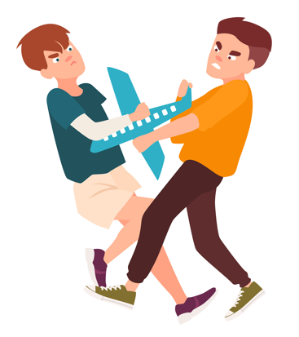
Situations for Mediation
In what circumstances can mediation be useful?
Discussion point: When two people are in conflict.
Notes:
NOTES TO THE TEACHER
Identify situations where mediation can be useful.
Invite the students to talk about conflicts they’ve had or heard about.
Discussion point: Mediation can be useful in many situations where at least two people are in conflict.
Answer Question 6 in the Student Workbook involving writing down examples of situations:
When students have a conflict at school.
When two people have different beliefs, values, opinions or cultures.
When parents separate.
When two companies disagree about what a contract means.
When two people want to avoid a long, expensive court case.

Slide 11
This is NOT Mediation!
What situations are not mediation?
Discussion point: Situations in which the solution is imposed…
Notes:
NOTES TO THE TEACHER
Think of situations that are not mediation
Ask the students to differentiate what is and is not mediation.
Answer Question 7 in the Student Workbook:
True or false for the characteristics of mediation:
The outcome is usually win-win or lose-lose. False
Only one solution is possible. False
The people involved find their own solution. True
The mediator can impose a solution. False
The mediator is neutral and impartial. True
Additional discussion points:
Characteristics of mediation:
The mediator is neutral and impartial.
The people in conflict find their own solution together.
The outcome is usually win-win.
Any solution is possible as long as it satisfies the people in conflict.
Characteristics of what IS NOT mediation:
One person influences the discussion or solutions or favours one person’s opinions or solutions.
One person imposes a solution (e.g., arbitrator or judge).
The outcome is usually win-lose or lose-lose.
Only one solution is possible (e.g., applying a law or regulation).

Slide 12
A Tale of Two Brothers
Two brothers want to watch different TV shows at the same time and are arguing over who gets control of the remote. They ask their father to settle the argument.
Outcome: Their father turns off the television and tells them to go outside and play. The father made the decision for the brothers.
Is this a situation of mediation? Why?
Notes:
NOTES TO THE TEACHER
Read the example of the situation that IS NOT mediation:
A Tale of Two Brothers…
Two brothers want to watch different TV shows at the same time and are arguing over who gets control of the remote. They ask their father to settle the argument.
Outcome: Their father turns off the TV and tells them to go outside and play. The father made the decision for the brothers.
Answer Question 8 in the Student Workbook:
Does this situation involve mediation? No
Why?
Possible answer: The father imposed the solution. The people involved in the conflict did not find a satisfactory solution for both sides (lose-lose outcome).
Reflection on the story: Rather than talking and trying to agree on a show they would both enjoy, the brothers can’t watch TV. Resolving a conflict does not necessarily lead to a happy ending …

Slide 13
The Advantages of Mediation
What are the advantages of resolving conflicts through mediation?
Discussion point: Why let someone else decide rather than talking to each other?
Notes:
NOTES TO THE TEACHER
Find the advantages of resolving conflicts through mediation.
Answer Question 9 in the Student Workbook on the advantages of mediation.
Discussion points: among other things, mediation allows the people in a conflict to…
find a solution for themselves.
find a solution that satisfies everyone.
resolve the conflict quickly (instead of dragging it out in court, for example).
keep discussions and agreements confidential.

Slide 14
Introducing the Players in Mediation

Slide 15
The Players in Mediation
Mediator
People involved in the conflict:
The Rotini Family
People involved in the conflict:
The Smith Family
Advisor
Advisor
Click here once all the players have been identified.
Expert
Notes:
NOTES TO THE TEACHER
Tips for leading the activity:
Ask the students to identify the players involved in mediation.
Once they have identified one of the players, click on the corresponding figure. This should take you to a slide with more information about that player.
As they identify the players, the students must write their names on the same diagram in their Student Workbook.
Once the player’s role is presented, click on the “Return to the diagram” icon on the bottom right to return to this slide. The name of the player should appear. ​
Once all of the players have been identified, click on the “Click here once all the players have been identified” icon on the bottom right. This will take you to “The Simulated Mediation Process” slide.
After identifying all of the players, answer Question 10 in the Student Workbook to summarize the description of each player.

Slide 16
People Involved in the Conflict
Role: Talk to one another to find a solution to their conflict.
Conduct:
Stay calm.
Listen carefully to the other players.
Be open to suggested compromises.
Return to the diagram

Slide 17
Advisors
Role: Advise one family during the mediation to help them reach their goals and feel satisfied.
Help their side prepare and negotiate during the session in order to avoid an outcome that is not in their interests.
Analyze the situation without letting emotions get in the way.
Conduct:
Be attentive.
Be objective
Act professionally.
Return to the diagram

Slide 18
Mediator
Role: Help the sides talk to one another to find a solution.
Help identify the conflict and what is important to each side.
Suggest ideas.
Ensure the mediation runs smoothly.
Conduct:
Be neutral.
Be positive and respectful.
Be calm.
Return to the diagram

Slide 19
Expert
Role: Give useful information to help the discussions move forward.
Settle an issue and give useful information.
Examples of useful information:
The value of an object
The number of sales in one week
An employee’s salary
*The teacher plays this role during the simulated mediation!
Return to the diagram

Slide 20
The Simulated Mediation Process

Slide 21
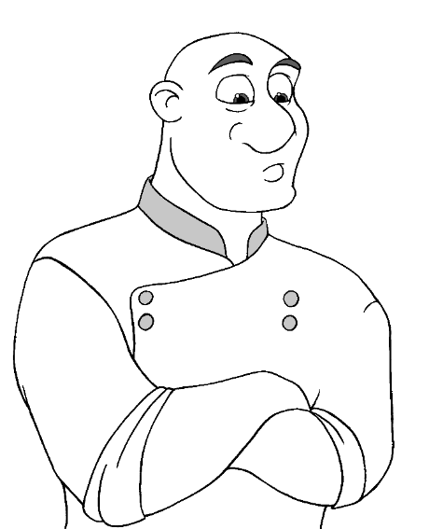
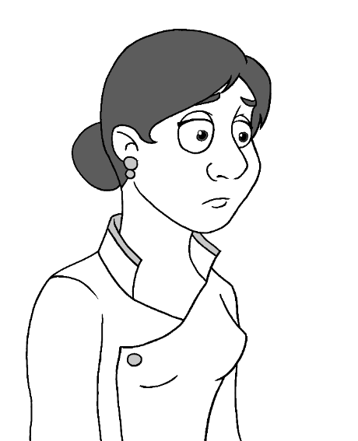
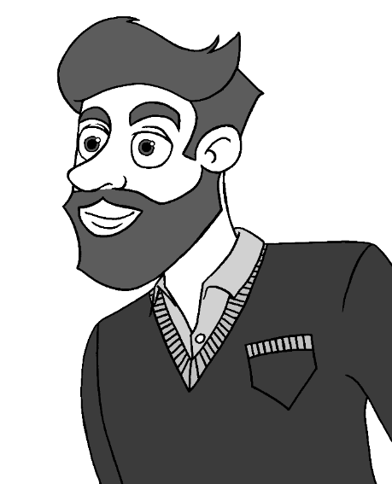
Assigning Roles
Mr. Rotini
Mrs. Rotini
Mrs. Smith
Mr. Smith
Rachel Rotini
Sarah Smith
Notes:
NOTES TO THE TEACHER
As a class, read the section The Simulated Mediation Process in the Student Workbook.
At this stage, assign a character to each student.
In addition to the family members, there will be mediators and advisors.
Divide the students into teams so that everyone participates in a simulated mediation.
Use the Assigning Roles table (Teaching Guide).
Each student must write down their role and their team number in their Student Workbook.
Hand out the Character Information Sheets and the Exercises to Prepare for the Mediation (Teaching Guide).

Slide 22
The Mediation Process
Introduction
Discussion
The mediator asks both sides to tell their story and what they want.
Conclusion
The mediator explains the rules.
The people involved in the conflict respectfully discuss the causes of their conflict and suggest solutions.
The players introduce themselves and sit down.
The mediator writes down what was said and agreed on.
Notes:
NOTES TO THE TEACHER
As a class, read this diagram, which is also presented in the Student Workbook.

Slide 23
The mediator can interrupt the discussion in these situations:
People are being disrespectful or are not following the rules.
People want to quickly consult their advisor.
The expert (the teacher) gives important facts so discussions can continue (e.g., the value of an object, the date of an event, a person’s salary, etc.).
Notes:
NOTES TO THE TEACHER
As a class, read the instructions, which are also presented in the Student Workbook.

Slide 24
Golden Rules of a Successful Mediation
Decide on at least 3 rules to follow during the mediation!
Discussion point: They must create an atmosphere that encourages discussion and respect for all players.
Notes:
NOTES TO THE TEACHER
The golden rules to follow during mediation (Student Workbook: Question 5 in The Mediation Process)
Identify at least 3 rules to follow during the mediation session. These rules are necessary to create an atmosphere that encourages discussion and respect for all players.
Examples:
The players must follow the mediator’s instructions.
The players must listen to the others, without interrupting.
The players must discuss calmly and respectfully.
The players must be open to new solutions.

Slide 25
Have a fun and successful mediation!
Notes:
NOTES TO THE TEACHER
The rest of the activity is done in the Student Workbook. The additional documents to print (Character Information Sheets, Exercises to Prepare for Mediation and Summary of the Agreement) are in the Teaching Guide.
Summary of the next steps:
1) Preparing for mediation (The students familiarize themselves with their character, complete the exercises to prepare and discuss with the other students playing the same role.)
2) Day of the mediation (The students playing the roles of the teens meet the members of their family and their advisor before the mediation. The simulated mediation is held.)
*During the mediations, the teacher can observe the students using the Observation Sheet in the Teaching Guide.
3) Conclusion (Ask questions as a way to conclude the activity, then have the students share their solutions.)
4) Evaluation (optional): See the Teaching Guide.

