Slide 1
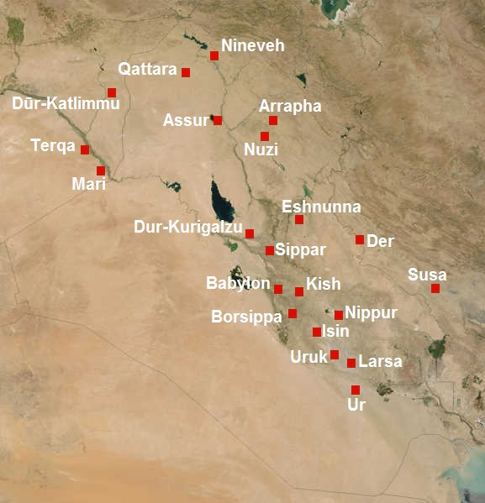
The Mesopotamian City-States and Justice
Notes:
TABLE OF CONTENTS
This guide is designed to be used in conjunction with the History and Citizenship Education program (Secondary 1). This PowerPoint presentation focuses on the legal aspects of the chapter entitled The emergence of a civilization.
The PowerPoint presentation is accompanied with the following student comprehension exercises:
Conceptual presentation of the State (20 minutes) - Exercises No. 1 and No. 2
The State and justice (20 minutes) - Exercises No. 3 and No. 4
Debate activity (20 minutes) - Exercise No. 5
In the notes for this presentation, you will find additional information and supplemental questions for the students if you would like to explore certain subjects in greater depth. Some slides contain a Resources section listing other texts or teaching resources that you can also share with your students.
There is also Sources section that contains the legal and non-legal sources for the information contained in the slides and notes.
NOTES TO TEACHER
Mesopotamian political life was organized in the form of city-states. In other words, each city, each town, was autonomous. Each had its own king, its own nobility and its own code of law. Generally, Mesopotamian city-states had the same powers as current States.
Although each Mesopotamian city usually worshipped a particular deity associated with that city, they all shared a very similar polytheistic religion structured around numerous gods, hundreds in fact. This formed the basis of what is referred to as "Mesopotamian culture", even though Mesopotamia itself was neither a state as such nor a homogeneous region.
The purpose of the following slides is to explain the nature of a State from a modern point of view.
PICTORIAL SOURCE:
CC BY-SA 2.5, https://commons.wikimedia.org/w/index.php?curid=18438114
Date sources updated: April 2020
Date created: April 2020

Slide 2
L’État et la Justice – Mésopotamie
What are the characteristics of a State
State and Justice – Mesopotamia
State and Justice – Quebec today
Debates!

Slide 3
The State :
What is it?
What are the characteristics of a State?
Notes:
Ask the students to do exercises No. 1 and 2 on the Student Exercise Sheet.
NOTES TO TEACHER
The State is everywhere and nowhere at the same time. You don't look at a police car, a member of parliament or even a teacher and say, "Look at that, it's the State!". Yet in Canada, the State decides radio frequencies, the content of nutrition labels on cereal boxes, what drugs are prohibited and what conduct is a crime. In some countries, the State can even sentence a person to death.…
So what do we mean by the "State", with a capital "S"?
Why and how can the State decide all these issues?
SOURCES
Radio: Loi sur la radiodiffusion, L.R.C. 1991, c 11, art 3 (1) a) et (2).
Étiquette nutritionnelle: Loi sur les aliments et drogues, L.R.C. (1985), c F-27, art 5 et Règlement sur les aliments et drogues, C.R.C c 870, art B.01.401 (1).
Drogues interdites: Loi réglementant certaines drogues et autres substances, L.C. 1996, c 19, art 4.
Faculté de dire que certains actes sont des crimes (voir LC 1867): Loi constitutionnelle de 1867 (R-U), 30 & 31 Vict, c 3, art. 91 par. 27.
Peine de mort dans certains pays:
Chine: Criminal Law of the People’s Republic of China (1997), section 5, art 48 à 51, en ligne: www.lawinfochina.com/display.aspx?lib=law&id=354&CGid (consulté le 2 avril 2020).
States-Unis: Dans les States qui l’ont légalisée, la peine de mort est acceptée pour les crimes contre la personne entraînant la mort, Kennedy v. Lousiana, 554 U.S. 407.

Slide 4
1. Territory
Canada
Notes:
NOTES TO TEACHER
A State must have a territory with well defined by borders established by human beings for the purpose of respecting certain "natural barriers", the geographic distribution of certain ethnic or religious groups living in the territory or created as the result of armed conflict. Such borders are also formalized in treaties (e.g., the Treaty of Westphalia of 1648, the Treaty of Paris of 1763).
A territory includes land, air and in some cases maritime areas ("territorial waters", near coastlines are part of a territory).
SOURCES
Convention de Montevideo, 26 décembre 1933, 165 RTSN 19, n° 3802, art. 1(II) (https://treaties.un.org/doc/Publication/UNTS/LON/Volume%20165/v165.pdf)
J.- Maurice ARBOUR et Geneviève Parent, Droit international public, 6e éd., Éditions Yvon Blais, Cowansville, 2012, p. 222 et suiv.
Convention des Nations Unies sur le droit de la mer, 0.747.305.15, 16 novembre 1994, art. 5 et 8(1) (https://treaties.un.org/doc/publication/CTC/Ch_XXI_6_french_p.pdf)

Slide 5
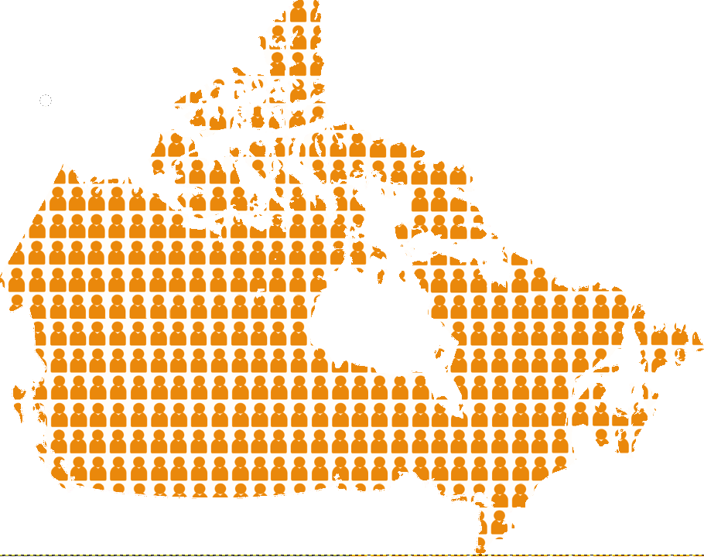
1. Population
Notes:
NOTES TO TEACHER
A State must have a permanent population.
This doesn't mean that no one is allowed to enter or leave the territory! What it does mean is that the territory is inhabited.
The population doesn't have to be evenly distributed throughout the territory. In Canada, for example, most of the population lives in the southern part of the country, near the US border.
SOURCES
Convention de Montevideo, 26 décembre 1933, 165 RTSN 19, n° 3802, art. 1(I) (https://treaties.un.org/doc/Publication/UNTS/LON/Volume%20165/v165.pdf)
Charte canadienne des droits et libertés, Loi de 1982 sur le Canada, Annexe B, 1982 (R-U), ch 11, art. 6.

Slide 6
3. Politique organisation
Notes:
NOTES TO TEACHER
A State must have a political organization, such as a government, laws and institutions.
You could give the students the following short definition of "institution": "An institution is not necessarily something physical. It’s a system, an organization in society. For example, the courts and Parliament are institutions. The concept is explained in greater detail in Module 2.
SOURCES:
Convention de Montevideo, 26 décembre 1933, 165 RTSN 19, n° 3802, art. 1(III) (https://treaties.un.org/doc/Publication/UNTS/LON/Volume%20165/v165.pdf)
Hubert REID, Dictionnaire de droit québécois et canadien: avec table des abréviations et lexique anglais-français, 5e édition, Montréal, Wilson & Lafleur, 2016, «Institution».

Slide 7
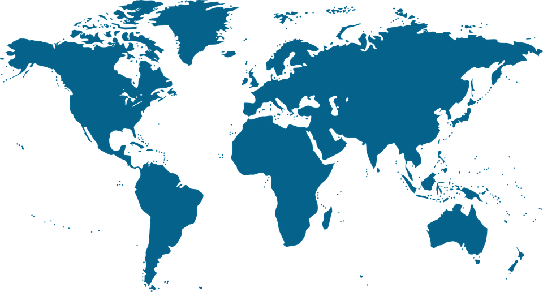
4. Relations avec d’autres États
Notes:
NOTES TO TEACHER
A State must have the capacity to form relations with other States. For example, it may establish diplomatic relations. Some States, like Canada, have embassies or consulates in almost every country of the world.
Embassies: Canadian embassies are, by definition, outside of Canada. Their role is to engage in diplomatic relations with the country in which they are located. For example, an embassy may authorize foreigners to travel in the country that the ambassador represents (issue visas).
Embassies are also useful for travelers. For example, if a tourist loses her passport or has serious problems while traveling, she could turn to the embassy of her country for assistance.
SOURCES
Convention de Montevideo, 26 décembre 1933, 165 RTSN 19, n° 3802, art. 1(IV) (https://treaties.un.org/doc/Publication/UNTS/LON/Volume%20165/v165.pdf)
Convention de Vienne sur les relations diplomatiques, 1961 (https://legal.un.org/ilc/texts/instruments/french/conventions/9_1_1961.pdf)
Convention de Vienne sur les relations consulaires, 1963 (https://legal.un.org/ilc/texts/instruments/french/conventions/9_2_1963.pdf)
Liste des ambassades canadiennes dans les autres pays: https://voyage.gc.ca/assistance/ambassades-consulats (consulté le 4 avril 2020).

Slide 8
The Canadian State

Slide 9
Canada is an example of a modern-day State
Canada is a federation
=
power is shared with:
and
The federal government ​
​ (of Canada)
The provincial governments
Notes:
NOTES TO TEACHER
A federation is a State in which power is shared with at least two orders of authority. In Canada, power is shared by the central (federal) government and the provincial governments. Both are described as “equal”, because they are each independent and autonomous.
Télé-Québec video clip: Les suppléants about the constitution and the levels of government: https://zonevideo.telequebec.tv/media/54299/les-palliers-gouvernementaux-et-la-constitution/les-suppleants
OPTIONAL INFORMATION
And where do the territories fit in all this?
The federal government is also responsible for three territories (the Northwest Territories, Nunavut and the Yukon), all of which have their own governments. However, these territorial governments don’t have “constitutional” powers like the provinces. Their powers are delegated to them by the Parliament of Canada.
SOURCES
Henri BRUN, Guy TREMBLAY et Eugène BROUILLET, Droit constitutionnel, 6E éd, Éditions Yvon Blais, Cowansville, 2014, par. VI-1.19 et VI-1.20.
Nicole DUPLÉ, Droit constitutionnel: principes fondamentaux, 7e éd., Wilson et Lafleur, Montréal, 2018, p.354-356.
Gouvernement du Canada, Différences entre les provinces et les territoires du Canada, Provinces et territoires, en ligne: https://www.canada.ca/fr/affaires-intergouvernementales/services/provinces-territoires.html (consulté le 2 avril 2020).

Slide 10
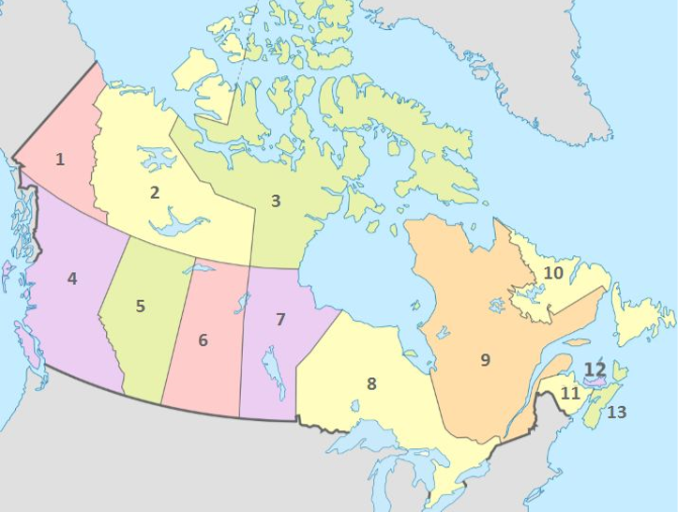
Canada
Canada is made up of:
Yukon
Northwest
Territories
Nunavut
10 provinces
3 territories
Newfoundland and Labrador
British - Columbia
Manitoba
The provinces and territories have the power to make certain decisions that concern them.
What is the capital of Canada? Do you know where it is?
Alberta
Prince Edouard Island
Ontario
Saskatchewan
Québec
New-
Brunswick
Nova Scotia
Notes:
NOTES TO TEACHER
Quiz!
1. How many provinces does Canada have?
2. How many territories does Canada have?
3. Can anyone name the territories and provinces on the map?
The 3 Territories
1. The Yukon
2. The Northwest Territories
3. Nunavut
The 10 provinces
1. British Columbia
2. Alberta
3. Saskatchewan
4. Manitoba
5. Ontario
6. Québec
7. Newfoundland and Labrador
8. New Brunswick
9. Prince Edward Island
10. Nova Scotia
Question: Where is the federal government?
The seat of the federal government is in Ottawa.
The federal government is concerned with matters that affect the country as a whole, such as currency or national defence
SOURCES
Gouvernement du Canada, Provinces et territoires, en ligne: http://www.cic.gc.ca/francais/nouveaux/pt/index.asp (consulté le 4 avril 2020).
Gouvernement du Canada, différences entre les provinces et les territoires: https://www.canada.ca/fr/affaires-intergouvernementales/services/provinces-territoires.html (consulté le 15 avril 2020)

Slide 11
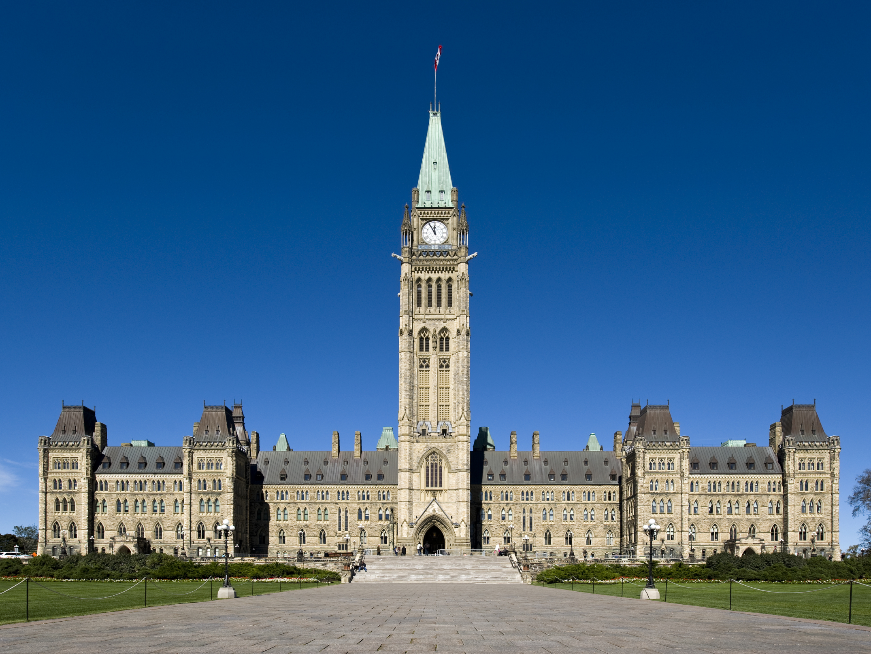
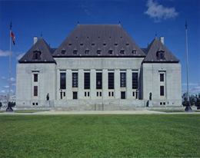
The capital of Canada
Ottawa is the capital of Canada. It’s in Ontario.
The following 2 important institutions are in Ottawa:
The Parliament of Canada
The Supreme Court of Canada
Notes:
NOTES TO TEACHER
Parliament: Parliament is where senators (appointed on the advice of the Prime Minister) and Members of Parliament (elected by the people) represent Canadians across the country. Parliament enacts laws governing all kinds of subjects in the general interest of the country
The Supreme Court: this is the highest court in Canada. After a trial, if one of the parties in the case thinks that the judge made a mistake, it can ''appeal'' the judge’s decision. Appeals are heard by the Court of Appeal of the province in which the trial was held. The role of an appeal court is not to hold the trial again. It can intervene only if the first judge made a mistake. If one of the parties believes that the Court of Appeal made an error, it can ask the Supreme Court of Canada to review the decision. The full Supreme Court is composed of 9 judges and every case must be heard by at least 5 judges. Supreme Court cases are decided by a majority vote of the judges and their decision is absolutely final.
SOURCES
Loi constitutionnelle de 1867 (R-U), 30 & 31 Vict, c 3, art. 17.
Loi sur la Cour suprême, LRC 1985, c S-26, art. 2, 4(1), 25, 35

Slide 12
Separate areas of jurisdiction
The federal government (in Ottawa) and the provincial governments can both make laws.
However, each government can only make laws covering specific subjects.
Notes:
NOTES TO TEACHER
The highest law of the land, the Constitution Act of 1867, assigned specific responsibilities to the federal and provincial governments. The Constitution provides a list of subjects on which the federal or provincial governments may respectively make laws. A few examples are given in the following slide.
OPTIONAL INFORMATION
Overlapping jurisdictions: There are some areas of competence that are not exclusive to either government. For example, the federal government and the provincial governments can both enact laws dealing with agriculture or immigration.
Residual federal powers: Because The Constitution Act was enacted in 1867, the framers at the time obviously could not predict all current fields of law, especially given all the technological advances that have been made. For example, aviation and the Internet did not exist in 1867. It’s up to the federal government to enact legislation in such new fields
SOURCES
Loi constitutionnelle de 1867, art. 91-95.
Henri BRUN, Guy TREMBLAY et Eugène BROUILLET, Droit constitutionnel, 6e éd, Éditions Yvon Blais, Cowansville, 2014, par. VI-2.17, VI-2.368-VI-2.372.
Nicole DUPLÉ, Droit constitutionnel: principes fondamentaux, 3e éd., Wilson et Lafleur, Montréal, 2014, p.53, 340 et 431-432.
Michel DESCHÊNES, « Les pouvoirs d’urgence et le partage des compétences au Canada », Les Cahiers de droit, vol. 33, no 4, 1992, p. 1181-1206, à la page 1198.

Slide 13
Federal
Provincial
Examples:
The army
Currency
Mail
Criminal law
Copyright
Examples:
Education
Hospitals
Ownership
Municipal affairs
Notes:
NOTES TO TEACHER
Although the federal and the provincial governments are "masters" of their distinct legal domains, they both have the same 3 powers: Legislative power to write laws; executive power to carry out laws; judicial power to interpret laws.
For example, Québec has full authority over education and Canada has exclusive authority over currency matters. But Canada has no authority to administer schools and Québec has no authority to create and issue a "Quebec dollar”.
SOURCES
Loi constitutionnelle de 1867, art. 91-93. 91(23), 91(24), 91(27), 92(7), 92(8), 92(16), 93.
Henri BRUN, Guy TREMBLAY et Eugène BROUILLET, Droit constitutionnel, 6e éd, Éditions Yvon Blais, Cowansville, 2014, par. II.131 et II.76 / VI-2.22 et VI-2.23 / VI-1.101, VI-2.310, VI-2.313 et suiv.
Nicole DUPLÉ, Droit constitutionnel: principes fondamentaux, 7e éd., Wilson et Lafleur, Montréal, 2018, p. 356-370.
Parlement du Canada, Les trois ordres d’administration, Notre pays, notre Parlement, Une introduction au fonctionnement du Parlement, en ligne: http://lop.parl.gc.ca/About/Parliament/Education/OurCountryOurParliament/html_booklet/three-levels-government-f.html (consulté le 2 avril 2020).

Slide 14
From the past to the present
Based on what you’ve learned, were the Mesopotamian City-States full-fledged states?
For the Mesopotamians, what is the role of the State in the administration of justice?
Notes:
This slide serves as the transition from explaining the concept of the State to explaining the concept of justice.
NOTES TO TEACHER
First question:
Yes. Mesopotamian city-states satisfied the conditions for recognition as States.
They each had their own territory, even though it was smaller than most modern-day States.
They each had a population.
They each had a political organization. Students will learn about the social pyramid of Mesopotamian societies in the chapter entitled Emergence of a civilization.
They each had relations with other States, especially other Mesopotamian city-states.
Second question:
The purpose of this question is not to get a right answer from the students, but rather to get them thinking about justice in society,
who makes the laws and who determines a person’s guilt or innocence.

Slide 15
The state and Justice

Slide 16
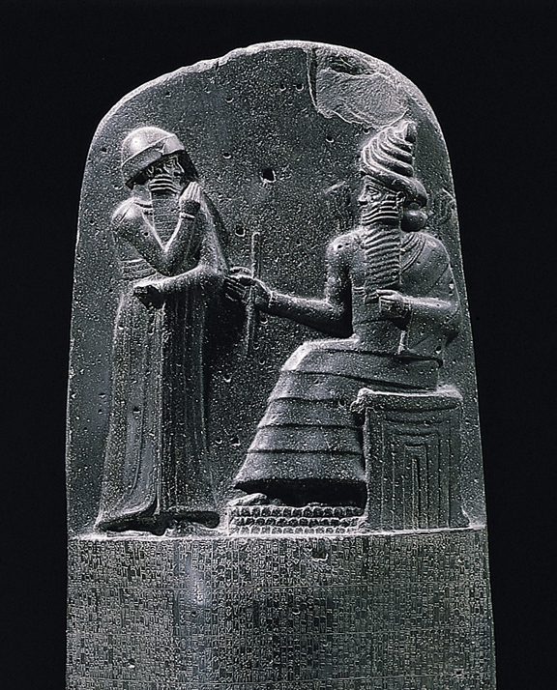
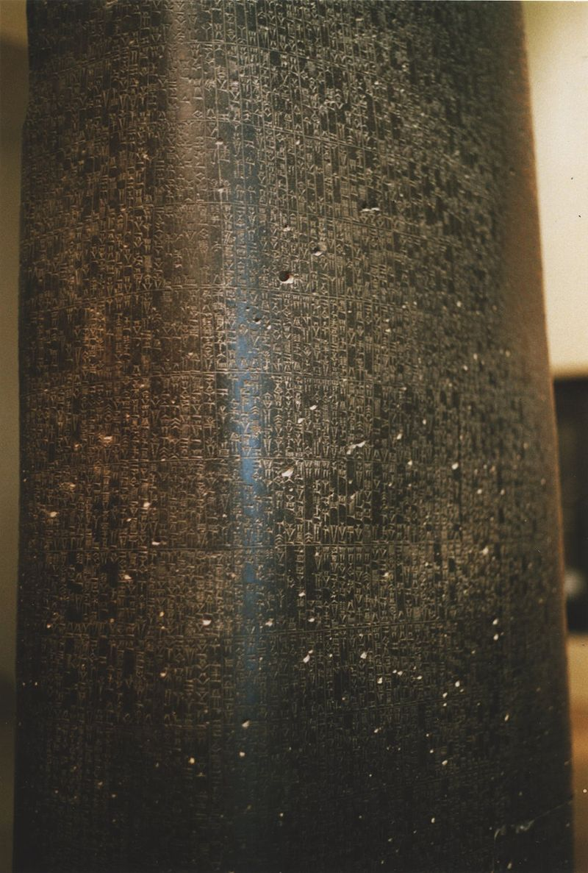
The State and justice
The concept of justice is constantly evolving.
The Code of Hammurabi (around 1750 BCE) ​
One of the oldest codes of law, it was discovered by archeologists at the beginning of the 20th century!
It was implemented by the Mesopotamian King Hammurabi and sets out what conduct is forbidden and the punishments for breaking the law. It has 182 articles of law.
Some of the punishments in the Code may seem rather extreme to us.
Notes:
Ask the students to do exercises No. 3 and No. 4.
NOTES TO TEACHER
Social norms existed well before 1750 BCE! Most historians agree that there were several clear prohibitions from the time people began living in groups: notably murder and incest.
The Code of Hammurabi is the oldest written code of laws discovered by archaeologists.
The stele (stone slab) on which the articles of law are inscribed can be seen in the Louvre Museum in Paris.
SUPPLEMENTAL QUESTIONS
Would you want to live a world that had no laws? What would be the consequences of that?
Do you think that 182 articles of law is too many? Do you think that Québec currently has a higher or lower number of rules?
What do you think of the student code of conduct? Do you think that the rules in the code make it easier to navigate through school life?
SOURCES
Code de Hammurabi, dans Wikipedia https://fr.wikipedia.org/wiki/Code_de_Hammurabi (consulté le 15 avril 2020)
Code de Hammurabi, roi de Babylone, dans https://www.louvre.fr/oeuvre-notices/code-de-hammurabi-roi-de-babylone (consulté le 15 avril 2020)
SOURCES ICONOGRAPHIQUES
Haut de la stèle: By Unknown author, Public Domain, https://commons.wikimedia.org/w/index.php?curid=135343
Le code: By Rama, CC BY-SA 3.0 fr, https://commons.wikimedia.org/w/index.php?curid=406241

Slide 17
Code of Hammurabi: articles 1 and 2
“A person found guilty of having put a curse on another person shall be put to death."
“If there is insufficient evidence and testimony to prove that a person put a curse on someone, the accused person shall be thrown into the rushing waters of the “divine river” and can only prove his innocence by surviving."
Notes:
NOTES TO TEACHER
These are the first two articles of the Code of Hammurabi. They set the tone for what follows: the death penalty and religious belief.
The Mesopotamians’ lack of scientific knowledge prevented them from properly understanding certain phenomena. They often explained them by citing witchcraft or possession by evil spirits.
They also believed that great misfortune could befall a person because someone cast an evil spell on that person.
The Mesopotamians believed in hundreds of gods that punish those who do wrong and reward those who honour them. This explains the Mesopotamian belief that if an accused was thrown into the river, and the river god would either punish him or save him depending on whether he was guilty or innocent. That practice is called trial by ordeal, or divine judgment, and was practiced in the western world until the Middle Ages (especially during the Inquisition).
SUPPLEMENTAL QUESTIONS
There is no mention in the Code of Hammurabi of how a person would go about proving a sorcerer’s guilt. Do you have any suggestions?
Who would be at a disadvantage in a trial by river ordeal? Would you have learned to swim if you were a Mesopotamian ?
SOURCES
Bulletins et Mémoires de la Société d'Anthropologie de Paris, Année 1910/1 /pp. 500-511
Francis JOANNÈS (dir.), Dictionnaire de la civilisation mésopotamienne, Paris, Robert Laffont, coll. « Bouquins », 2001
Jean BOTTÉRO, Mésopotamie, L'écriture, la raison et les dieux, Paris, Gallimard, coll. « Folio Histoire », 1997

Slide 18
Code of Hammurabi : article 6
"A person who steals property from a temple or the court, as well as the receiver of that property, shall be put to death."
Notes:
NOTES TO TEACHER
Temple: the name given to the places of worship of many religions of Antiquity. They’re a bit like churches for Christians or mosques for Muslim.
Court: the word “court" used in this context refers to the royal palace.
Receiver: a receiver is a person who is knowingly in possession of stolen property for the purpose of keeping it or reselling it.
SUPPLEMENTAL QUESTIONS
The death penalty was given for theft only if the crime was committed in a temple or the royal palace. What does that tell you about Mesopotamian society?
Do you think that being in possession of stolen property is as serious as being a thief? Should the receiver of stolen property be given the same punishment as the thief?
It would be interesting to point out that receiving and selling stolen goods (commonly referred to as fencing] is still a crime in Canada.
SOURCES
Bulletins et Mémoires de la Société d'Anthropologie de Paris, Année 1910/1 /pp. 500-511
Code criminel, LRC, (1985) ch C-46, art. 354(1).

Slide 19
Code of Hammurabi : article 15
“Helping a slave to escape is punishable by death.“
Notes:
NOTES TO TEACHER
Slavery was very widespread in the civilizations of Antiquity, and the Mesopotamians were no exception. In most civilizations that practice slavery, slaves are not regarded as ''persons'' in law. They are viewed as property, as possessions belonging to other people. Thus, depriving someone of his or her slave, even if only by helping that slave escape, was regarded as theft.
Strange as it may seem, in the Code of Hammurabi, killing a slave was not punishable by death. The murder’s punishment was to reimburse the master for the price paid for the slave. A likely explanation is that the severity of the penalty for kidnapping a slave or helping the slave to escape was intended to maintain the institution of slavery, rather than punish the perpetrator of the crime.
In Canada, slavery was abolished before Canada officially became a country. Slavery was legally abolished in the British colonies in 1834 and because the territory that became Canada was a British colony, slavery was banned throughout the territory.
SOURCES
Bulletins et Mémoires de la Société d'Anthropologie de Paris Année 1910/1 /pp. 500-511
Christian Delacampagne, Histoire de l'esclavage. De l'Antiquité à nos jours, Paris, Le livre de poche, 2002, p.30-33
Gouvernement du Canada, « L’abolition du commerce de l’esclavage et de l’esclavage dans l’Empire britannique » (16 janvier 2017). (https://www.canada.ca/fr/patrimoine-canadien/campagnes/mois-histoire-des-noirs/principaux-evenements/abolition-esclavage.html)
L’Encyclopédie canadienne, « ​Abolition de l’esclavage, loi de 1833 » par Natasha L. Henry. (https://www.thecanadianencyclopedia.ca/fr/article/abolition-de-lesclavage-loi-de-1833)

Slide 20
Code of Hammurabi : articles 196 and 200
If a man destroys the eye of a nobleman, his eye shall be destroyed “.
“If a man knocks out the tooth of a man of his own rank, his tooth shall be knocked out. “
Notes:
NOTES TO TEACHER
This slide is about the implementation of the philosophy of Lex Talionis or "law of retaliation". According to that legal philosophy, criminals are punished by subjecting them to punishment modeled on the crime that was committed. The word Talionis comes from the Latin word talis, meaning “of such kind”. The law of retaliation is symbolized by the expression "An eye for an eye, a tooth for a tooth", which has its origin in these articles in the Code of Hammurabi.
Today, the principle of Lex Talionis no longer operates in most societies and cultures. Gandhi is reported to have said that in a system based on revenge, ”an eye for an eye leaves the whole world blind”.
OPTIONAL INFORMATION
Although today we consider this vision of justice severe and violent, at the time it ensured that social peace was maintained. Before the implementation of Lex Talionis, a person who was injured often took the law into his own hands and exacted revenge that often was worse than the original crime, setting in motion a series of escalating retaliations between the parties involved. To some extent, Lex Talionis helps prevent such cycles of violence while allowing victims to feel that justice has been done.
SUPPLEMENTAL QUESTIONS
In Quebec today, does the law provide punishments that involve violence or corporal punishment?
At lunchtime, Adam is hit in the face by a co-worker. The next day, seeking revenge, Adam goes to his co-worker’s office and hits him back. Who will be punished?
Answer: Both of them could be charged with assault. Some students may raise the issue of self-defense. However, the argument of self-defence is valid only if a person fears for his life or physical safety and has no option but to use violence to escape attack. In our story, Adam goes back the next day to hit his assailant. He is not defending himself — he is taking revenge, which is not allowed. He could report the assault to the police and then take part in the case against his co-worker.
SOURCES
Bulletins et Mémoires de la Société d'Anthropologie de Paris Année 1910/1 /pp. 500-511

Slide 21
Code of Hammurabi : articles 209 and 210
“If a person strikes a nobleman’s pregnant daughter and she then suffers a miscarriage, that person must pay 10 shekels of silver as compensation for the loss of the unborn child. If the woman dies, the assailant’s daughter shall be put to death.“
“If a person strikes a common man’s pregnant daughter and she then suffers a miscarriage, that person must pay 5 shekels of silver. If the woman dies, the person must pay one-half a mina.“
Notes:
NOTES TO TEACHER
Mesopotamian societies placed great importance on social class. A minority of the population were members of the nobility and were considered more important or of greater worth. Therefore, in many articles of the Code of Hammurabi, crimes committed against members of the nobility are very often punished more severely than those committed against commoners or peasants.
The shekel was the currency used in Babylon at the time of King Hammurabi. It would be too complicated to calculate what 10 shekels of silver would be worth in today's Canadian dollars.
The Mesopotamians extended the principle of Lex Talionis to certain people who had not done anything wrong. Thus, in the first article, the assailant’s daughter would be killed even though she had not committed any crime. The objective of justice at the time was to satisfy the victims so that they would not take revenge themselves, rather than to punish the perpetrators.
SOURCES
Bulletins et Mémoires de la Société d'Anthropologie de Paris Année 1910/1 /pp. 500-511

Slide 22
What examples struck you particularly as showing the difference between our vision of justice that of the Mesopotamians?
Notes:
If an answer comes up often or if you think it is particularly pertinent, enter it in the grey rectangle.
QUESTIONS TO STUMULATE DISCUSSION:
In today’s society, are there any social groups that have an advantage over other social groups?
Does Canada still have the death penalty?
Answer: No, it was abolished in 1976.
Is this the case everywhere in the world?
Answer: Some countries still have the death penalty, such as China and a few American states.
Which articles of the Code of Hammurabi presented today strike you the unfairest ones?
SOURCES
L’Encyclopédie canadienne, « Peine capitale » par Paul GENDREAU et Wayne RENKE. (https://www.thecanadianencyclopedia.ca/fr/article/peine-capitale)
Loi annuelle du Canada 1974-1976, chap 13, art. 13.
Criminal Law of the People’s Republic of China (1997), section 5, art 48 à 51, en ligne: www.lawinfochina.com/display.aspx?lib=law&id=354&CGid (consulté le 2 avril 2020).
Kennedy v. Lousiana, 554 U.S. 407.

Slide 23
The State and justice: in modern-day Québec
Where can we find the laws and regulations that govern our daily lives as members of society?
Can you name some specific consequences for not complying with the law?
Notes:
INFORMATION FOR THE STUDENTS
The law today is much more complex than it was in Mesopotamia. We now have very specific fields of law such as criminal law, family law and business law. In Québec, there are thousands of legal provisions regulating all aspects of society. Some affect our daily lives (the articles in the Civil Code or the sections of the Highway Safety Code), whereas others regulate specific situations (for example, the sections of the Land Surveyors Act or the Archives Act).
Ignorance of the law is no defence! Some legal prohibitions are already well known, such as those against killing, assault, and stealing, etc. But even for lesser-known prohibitions, a person who has unwittingly broken the law cannot use ignorance of the law as a defence. For example, "I didn't know I’m not allowed to wear my headphones when I ride my bike" won’t save you from having to pay the ticket that the police officer gives you .
So where can we find our laws?
All laws and regulations are in various codes and laws and are available online. (For Quebec laws and regulations: http://legisquebec.gouv.qc.ca/)
Éducaloi is also a good resource if you have any questions !
Consequences for breaking the law. The students will probably say “fines” and jail:. This is partly correct. You should point out that there are other penalties such as community service, monetary compensation and house arrest.
SUPPLEMENTAL QUESTIONS
Are the consequences the same for teenagers who commit crimes?
Answer: Teenagers who commit crimes are governed by the Youth Criminal Justice Act. They are not subject to the same punishment as adults. To find out more, consult our information file on the subject.
Are the consequences the same if a person breaks the same law several times?
Answer: In Canada, if a person is convicted of the same offence more than once, the second punishment could be more severe than the first.
SOURCES
Code criminel, LRC, (1985) ch C-46, art. 19
Code de la sécurité routière, RLRQ c C-24.2, art. 443.2 al.1.

Slide 24
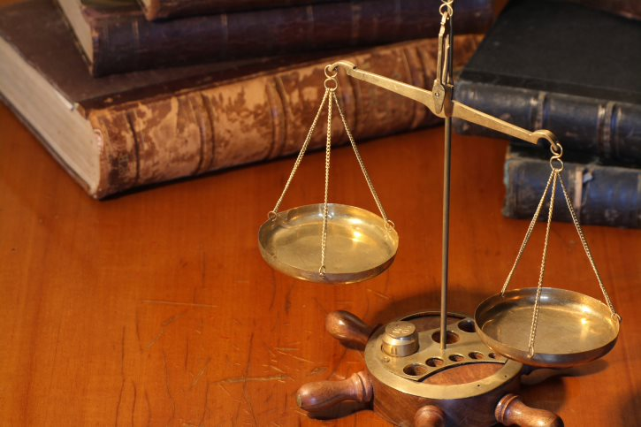
The State and justice: in modern-day Québec
The presumption of innocence:
“Innocent until proven guilty”
Equality of all before the law:
The principle that the law applies to everyone equally.
Notes:
INFORMATION FOR STUDENTS
Presumption of innocence
In Canada, a person accused of committing a crime is presumed innocent until found guilty by a judge or jury .
An accused person does not have to prove his or her innocence. The State (represented by a prosecutor in criminal and penal proceedings) must prove that the accused is guilty beyond a reasonable doubt.
At the end of the trial, if the prosecutor has not presented sufficient evidence or if the judge or jury still has a reasonable doubt about the accused person’s guilt, then the accused person must be found not guilty (i.e. acquitted of the crime).
Equality before the law:
This is the principle that no one is above the law, that the law applies to everyone equally regardless of title or social status.
The law makes no exception and applies equally to everyone. We are all entitled to the same protection and the same benefits under the law, without discrimination.
SUPPLEMENTAL QUESTIONS
In Mesopotamia, if it was impossible to prove the guilt or innocence of an accused person, the accused had to undergo trial by ordeal. What happens today if there is insufficient evidence or witness testimony at trial to make a clear finding one way or the other?
Answer: the presumption of innocence applies!
SOURCES
Loi constitutionnelle de 1982, Annexe B de la Loi de 1982 sur le Canada (R-U), 1982, c 11, art. 11d) et 15(1)
Roncarelli c. Duplessis, [1959] SCR 121

Slide 25
Discussions
Notes:
NOTES TO TEACHER
Teachers have two discussion options .
1. Ask the students to answer question No. 5 on the Student Exercise Sheet and then have the students deal with it as a group. The teacher would ask for a show of hands indicating how many are for and how many are against the proposition. The teacher then calls on students willing to justify their position and explain why they are either “for” or “against” it.
2. The teacher would ask for a show of hands indicating how many are “for” and how many are “against” a particular proposition. The teacher would then ask those students who want to express their opinion in writing to do so and explain why they are “for” or “against” it. Those students should then write their personal opinion regarding question No. 5 on the exercise sheet.
All three discussion slides have notes to guide the teacher.

Slide 26
The right to vote should be taken away from seniors.
For or against?
Notes:
INFORMATION TO BE GIVEN TO STUDENTS (IF DISCUSSION STALLS)
ARGUMENTS FOR:
It would prevent old people from making decisions that would affect young people .
Some very old people do not have all their mental faculties .
ARGUMENTS AGAINST:
We would be depriving ourselves of the wisdom of age, of valuable experience gained over a lifetime.
Just because seniors are approaching the end of life, doesn’t mean that they would make decisions contrary to the interests of younger people .
Depriving seniors of the right to vote would be discrimination
Discrimination is…
Not respecting a persons right to equality :
by preventing that person from exercising the same rights or having access to the same services as everyone else;
on the basis of personal characteristics recognized by the charters as prohibited grounds of discrimination:
Religion
handicap
ethnic or national origin
age (but the law can base certain prohibitions on age, for example forbidding the sale of alcoholic beverages to people under the age of 18).
etc.
NOTE TO TEACHER
Éducaloi offers a teaching tool on the Charters and discrimination at school. Visit our website:
https://www.educationjuridique.ca/en/doityourself/teachingguides/discrimination-at-school/
SOURCES
Charte des droits et libertés de la personne, L.R.Q., c. C-12, art. 10.
Loi constitutionnelle de 1982, 1982, ch. 11 (R.U.), Annexe B, art. 2(b). art. 15.
Andrews c. Law Society of British Columbia, [1989] 1 R.C.S. 143, page 38 [du document PDF].
Christian Brunelle, Les domaines d’application des Chartes des droits, Collection de droit 2012-2013, Volume 7, Droit public et administratif, p.30 et 52.

Slide 27
Canada should bring back the death penalty
For or against?
Notes:
INFORMATION TO BE GIVEN TO STUDENTS (IF DISCUSSION STALLS)
Canada has not had the death penalty since1976.
ARGUMENTS FOR:
A person who spends his life in prison costs the State a lot of money.
The death penalty could act as a deterrent against violent crime.
ARGUMENTS AGAINST:
Sometimes judges or juries are wrong and find an innocent person guilty of a crime punishable by death.
Allowing a State to kill its citizens, for whatever reason, is a slippery slope. The State would be venturing onto very dangerous ground. For example, in some countries, the State uses this power to get rid of its political opponents.

Slide 28
Canada should have a King or Queen
For or against
Notes:
INFORMATIONS À TRANSMETTRE AUX ÉLÈVES
Trick question! Canada has a King! In the Canadian Constitution, the King of England is our head of State, represented at the federal level by the Governor General of Canada and at the provincial level by a Lieutenant Governor. However, the King alone cannot make decisions affecting us. In practice, Canada is governed by the Cabinet (the Prime Minister and his or her selected ministers, as well as the Governor General, whose role is very limited) .
OPTIONAL INFORMATION
Historically, the Government of Canada is tied to the British Crown, which is why government lawyers in criminal cases are usually referred to as “Crown Prosecutors”.
Crown Prosecutors (officially called Criminal and Penal Prosecuting Attorneys in Québec) prosecute, on behalf of the State, people suspected of having committed crimes. This is why the names of court cases in criminal matters always take the same form: The King (Regina) against (versus) the accused person (e.g., R. v. Armitage) .
U.S. criminal cases take the following form: “The People” against the accused person, as a reminder that the purpose of criminal prosecutions is to protect the interests of society generally .
SOURCES
Loi constitutionnelle de 1867 (R-U), 30 & 31 Vict., c 3, art 9, reproduit dans LRC 1985, annexe II, n³5.
Code criminel, art 2, subverbo «poursuivant» et «procureur général».
Pierre BÉLIVEAU et Martin VAUCLAIR, Traité général de preuve et de procédure pénales, 22e éd, Yvon Blais, 2015, p 95-105.

Slide 29
Instagram/educaloi_en
YouTube/educaloi
Facebook/educaloi
educaloi.qc.ca/en

