Slide 1
Discrimination at school?

Slide 2
Discrimination à l'école?
Charters
The Canadian Charter
The Quebec Charter
Discrimination
Direct discrimination
Indirect discrimination

Slide 3
The Charters :
​ Protecting Rights and Freedoms

Slide 4
What is a charter?
It is a text describing the main human rights and freedoms that a society protects.
In Quebec, there are two charters that protect our rights:
The Canadian Charter of Rights and Freedoms (Canadian Charter)
The Charter of Human Rights and Freedoms (Quebec Charter)
Notes:
SOURCES
Charte canadienne des droits et libertés, art 1, partie I de la Loi constitutionnelle de 1982, constituant l’annexe B de la Loi de 1982 sur le Canada (R-U), 1982, c 11 [ci-après Charte canadienne]
Charte des droits et libertés de la personne, RLRQ c C-12, préambule [ci-après Charte québécoise].

Slide 5
A Few Differences…
Adopted in 1982
Protects the rights of Aboriginal peoples
Protects rights related to the use of French and English
Adopted in 1975
Provides more explicit protection for certain rights, such as privacy rights
Protects social and economic rights (e.g., free public education, fair and reasonable work conditions)
Notes:
SOURCES
Charte canadienne, art 16-23, 25, 35.
Charte québécoise, art 4-9, 39-48.

Slide 6
Some Similarities
Some rights protected by both charters:
Right to life, liberty and security
Freedom of expression
Freedom of religion
Right to a lawyer
Right to be tried within a reasonable time
Right against unreasonable search and seizure
Right to equality and non-discrimination

Slide 7
Who must respect the charters?
Laws must respect the charters…
All laws adopted in Canada, including those adopted in Quebec, must respect the Canadian Charter.
On the other hand, only Quebec laws must respect the basic rights in the Quebec Charter.
But, not only laws…
The federal and provincial governments (departments, etc.) must respect the Canadian Charter.
The Quebec government, individuals and most organizations in Quebec must also respect the Quebec Charter (companies, schools, etc.)
Notes:
SOURCES
Charte canadienne, art 24(1), 32(1), 52(1).
Charte québécoise, art 49, 52, 54, 55.
Godbout c Longueuil (Ville), [1997] 3 RCS 844 au para 93.
SDGMR c Dolphin Delivery Ltd, [1986] 2 RCS 573 aux para 33-34.
Christian Brunelle, Les domaines d’application des Chartes des droits, Collection de droit 2016-2017, vol 7, tit I, ch III aux pp 35-39.

Slide 8
Discrimination is…
not respecting someone’s right to equality
by preventing that person from enjoying the same rights and services as others
because of a characteristic recognized by the charters:
Religion
disability
ethnic or national origin
etc.
Can you name other similar characteristics mentioned in the charters?
Notes:
SOURCES
Charte canadienne, art 15(1).
Charte québécoise, art 10.
Andrews c Law Society of British Columbia, [1989] 1 RCS 143 aux pp 174-175.
Christian Brunelle, Les domaines d’application des Chartes des droits, Collection de droit 2016-2017, vol 7, tit I, ch III aux pp 64-67.

Slide 9
Some Prohibited Grounds of Discrimination
gender
civil status
disability
religion
language
social status
sexual orientation
political beliefs
skin colour
pregnancy
Notes:
SOURCES
Charte canadienne, art 15(1).
Charte québécoise, art 10.

Slide 10
Direct discrimination
This is when a rule or action specifically targets certain people.
​
Example: a school board decides not to admit Blacks.
​
​
This rule is directly discriminatory because it prevents certain people from attending school like everyone else.
​
The rule is invalid…
and prohibited by the charters.
Notes:
SOURCES
Commission ontarienne des droits de la personne c Simpsons-Sears, [1985] 2 RCS 536 aux pp 551 et ss.
Christian Brunelle, Les domaines d’application des Chartes des droits, Collection de droit 2016-2017, vol 7, tit I, ch III aux pp 64-67.

Slide 11
Indirect discrimination
This is when a rule or action applies to everyone , but the effect of the rule prevents certain people from exercising their rights.
Example: a school board decides that no animals can be in its schools.
This rule indirectly prevents blind people accompanied by seeing-eye dogs from attending school like everyone else.
The rule is valid…
… but an exception should be considered.
Notes:
SOURCES
Commission ontarienne des droits de la personne c Simpsons-Sears, [1985] 2 RCS 536 aux pp 551 et ss.
Christian Brunelle, Les domaines d’application des Chartes des droits, Collection de droit 2016-2017, vol 7, tit I, ch III aux pp 64-67.

Slide 12
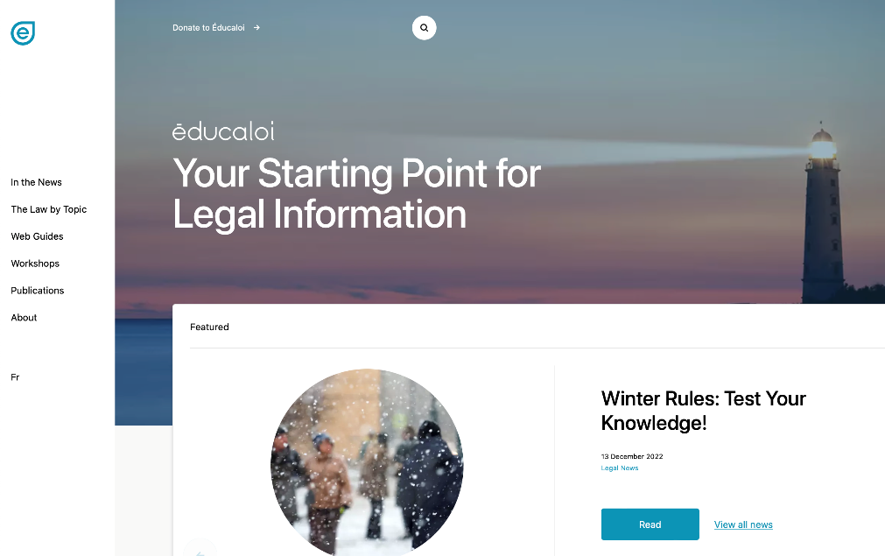
Instagram/educaloi_en
YouTube/educaloi
Facebook/educaloi
educaloi.qc.ca/en

