Slide 1
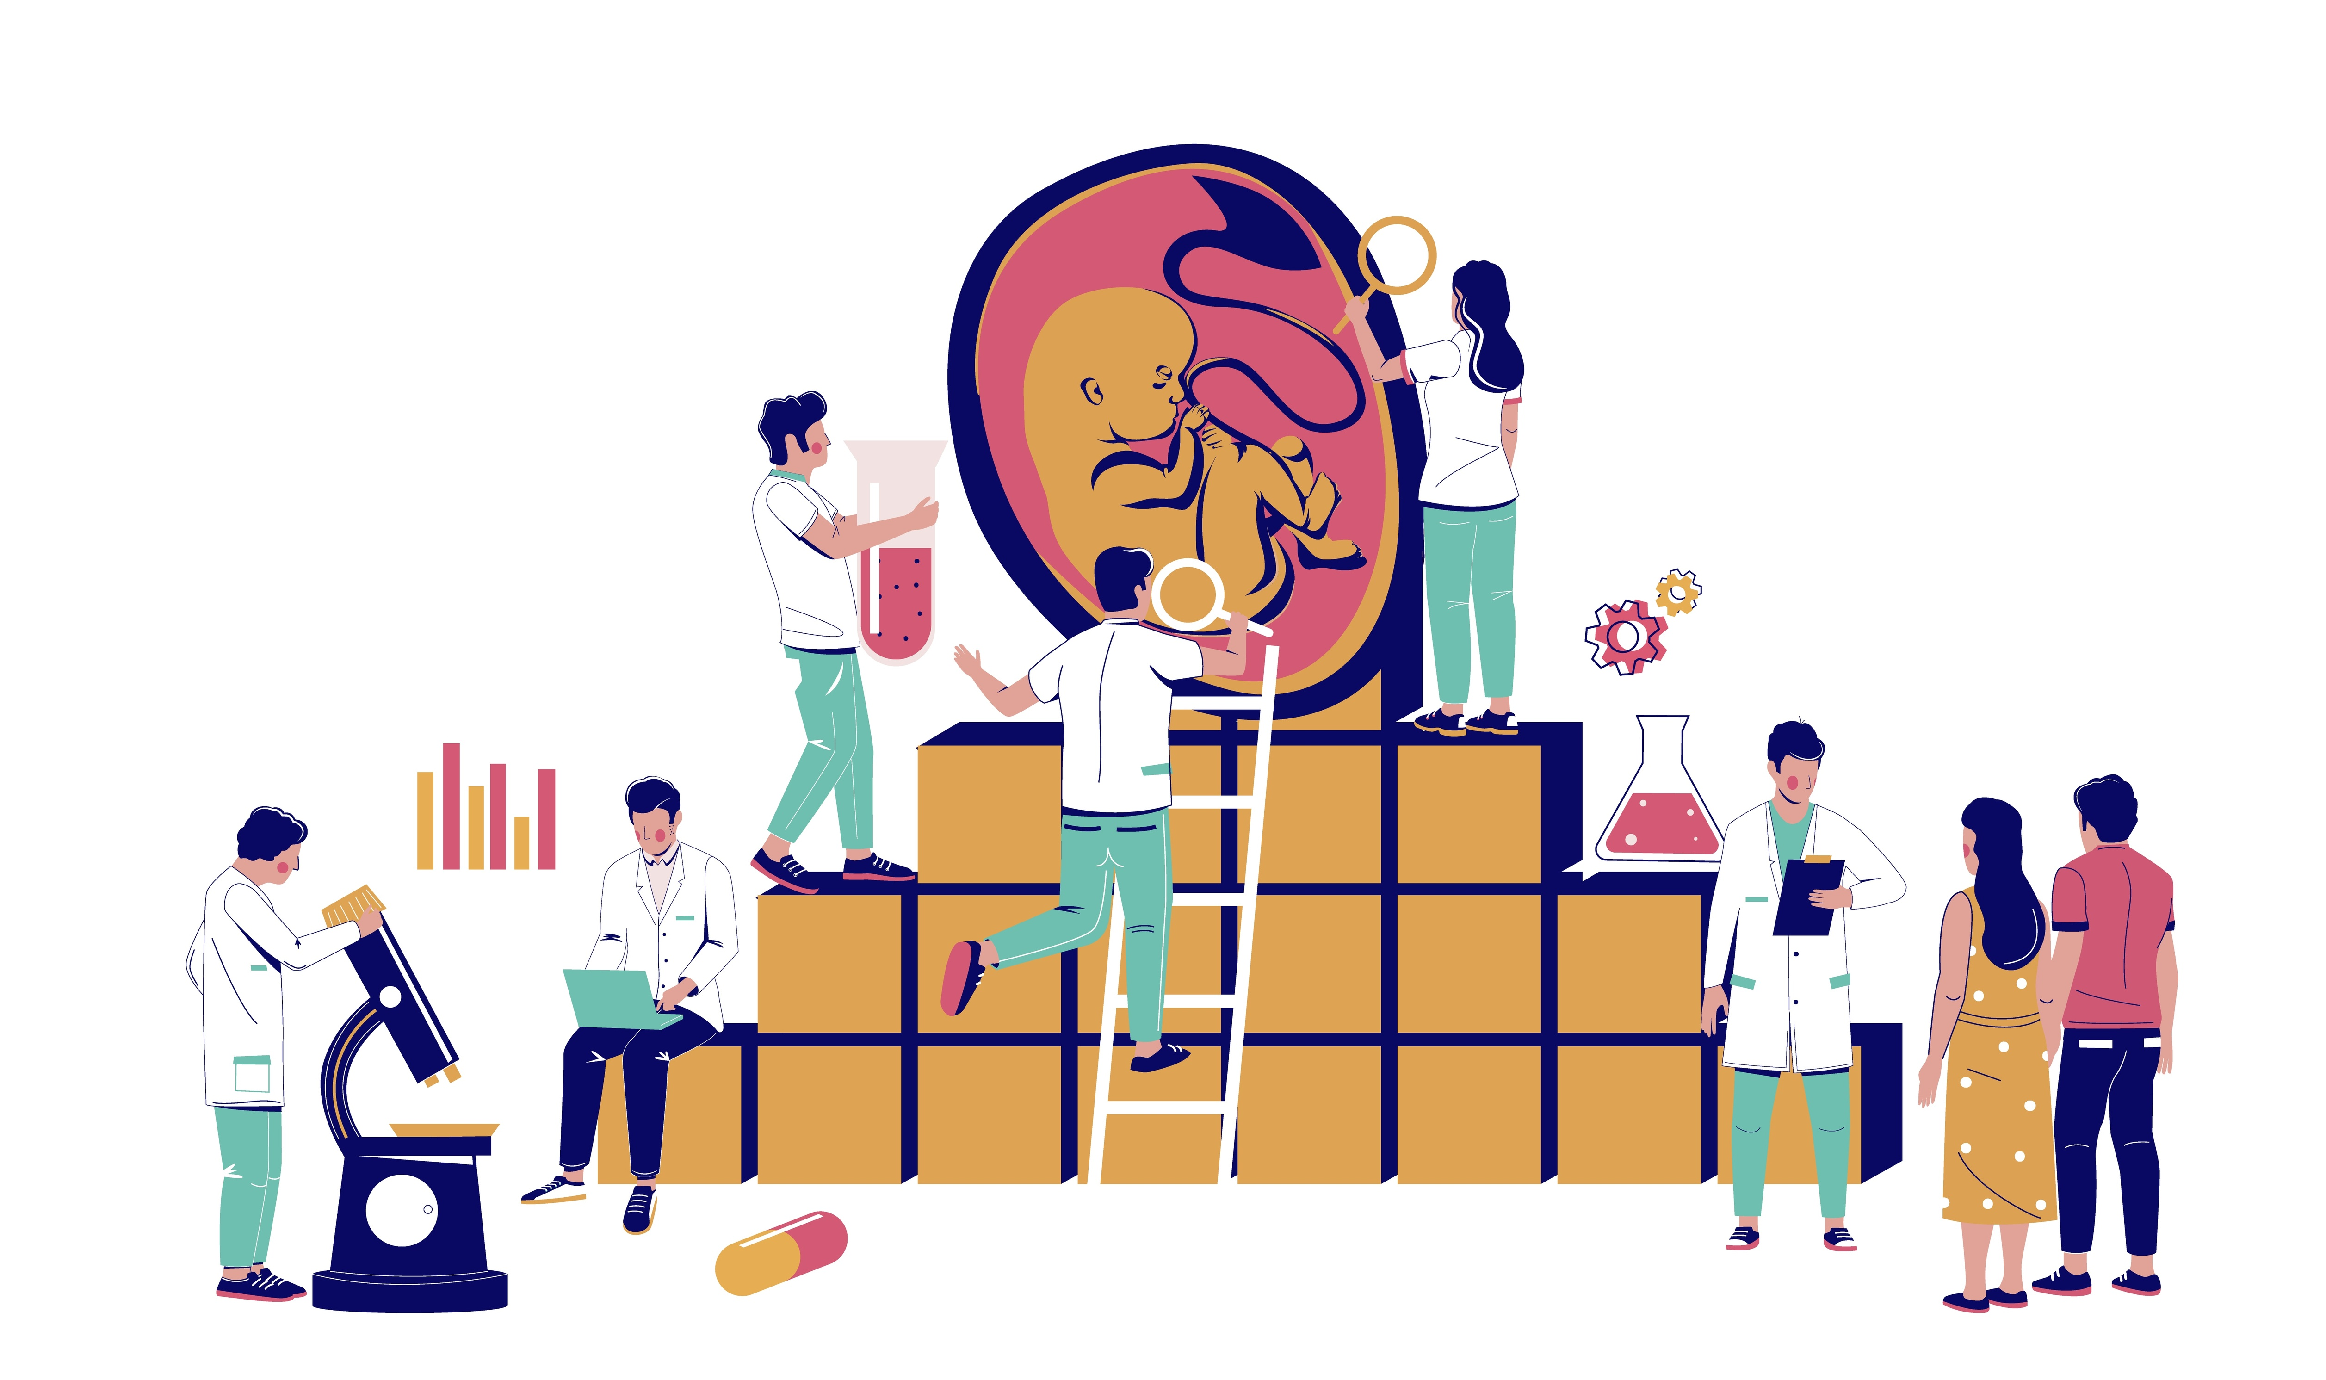
Bioethics: Saviour Babies
Notes:
NOTES FOR THE TEACHER
This PowerPoint presentation is intended to be used in conjunction with the “Bioethics: Saviour Babies” activity. Most of the information it contains illustrates the various steps outlined in the Student Workbook. A couple of videos are included to enrich the content of the presentation.
The proposed exercises are ready-to-use suggestions to run the activity and encourage your students’ participation.
The notes section of several slides include “NOTES FOR THE TEACHER," which provide specific information for the activity.
© Éducaloi, 2024

Slide 2
Introduction to bioethics
Notes:
NOTES FOR THE TEACHER
Watch the video.
Ask students questions to assess their understanding. Ask them whether they have ever heard of bioethics.

Slide 3
What is a saviour baby?
A saviour baby is a child conceived to cure a person who has an illness.
Background: Imagine that you have an illness, and the only cure is a stem cell donation from another person.
In this activity, you will draft a bill to regulate the creation of saviour babies.
Notes:
NOTES FOR THE TEACHER
Read the information on the slide with the students. (The same information is provided on p. 4 of the Student Workbook.)
According to the Senate of Canada: A bill is a proposal to create a new law, or to change or repeal an existing one.

Slide 4
What is a saviour baby?
?
?
?
Have you ever heard of saviour babies?
What first thoughts come to mind?
?
Notes:
NOTES FOR THE TEACHER
Ask students questions to assess their understanding of saviour babies.
Encourage students to share their initial impressions.
Examples of questions you can ask students:
Do you think that all countries should allow the creation of saviour babies?
What are the benefits of creating saviour babies?
What are the risks of creating saviour babies?
Could we decide on criteria or conditions to determine whether to allow the creation of saviour babies? If so, which ones?
The purpose of this activity is to establish criteria by drafting a bill on this subject.

Slide 5
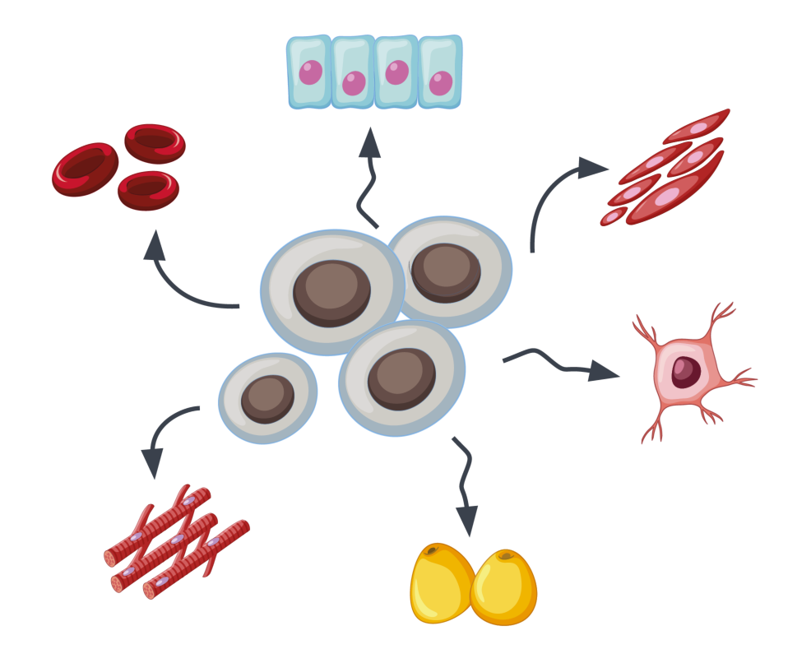
Stem cells
Stem cells are parent cells that give rise to all other cells in the human body.
For example, some stem cells lead to the production of red and white blood cells.
Notes:
NOTES FOR THE TEACHER
Read the information on the slide with the students. (The same information is provided on p. 4 of the Student Workbook.)
Continue reading from p. 4 of the Student Workbook:
Stem cells are parent cells that give rise to all other cells in the human body.
For example, some stem cells lead to the production of red and white blood cells.
If a disease (such as leukemia) or a treatment (such as chemotherapy) disrupts the development of these stem cells, you may end up having too few red or white blood cells and become extremely weak or die as a result.

Slide 6
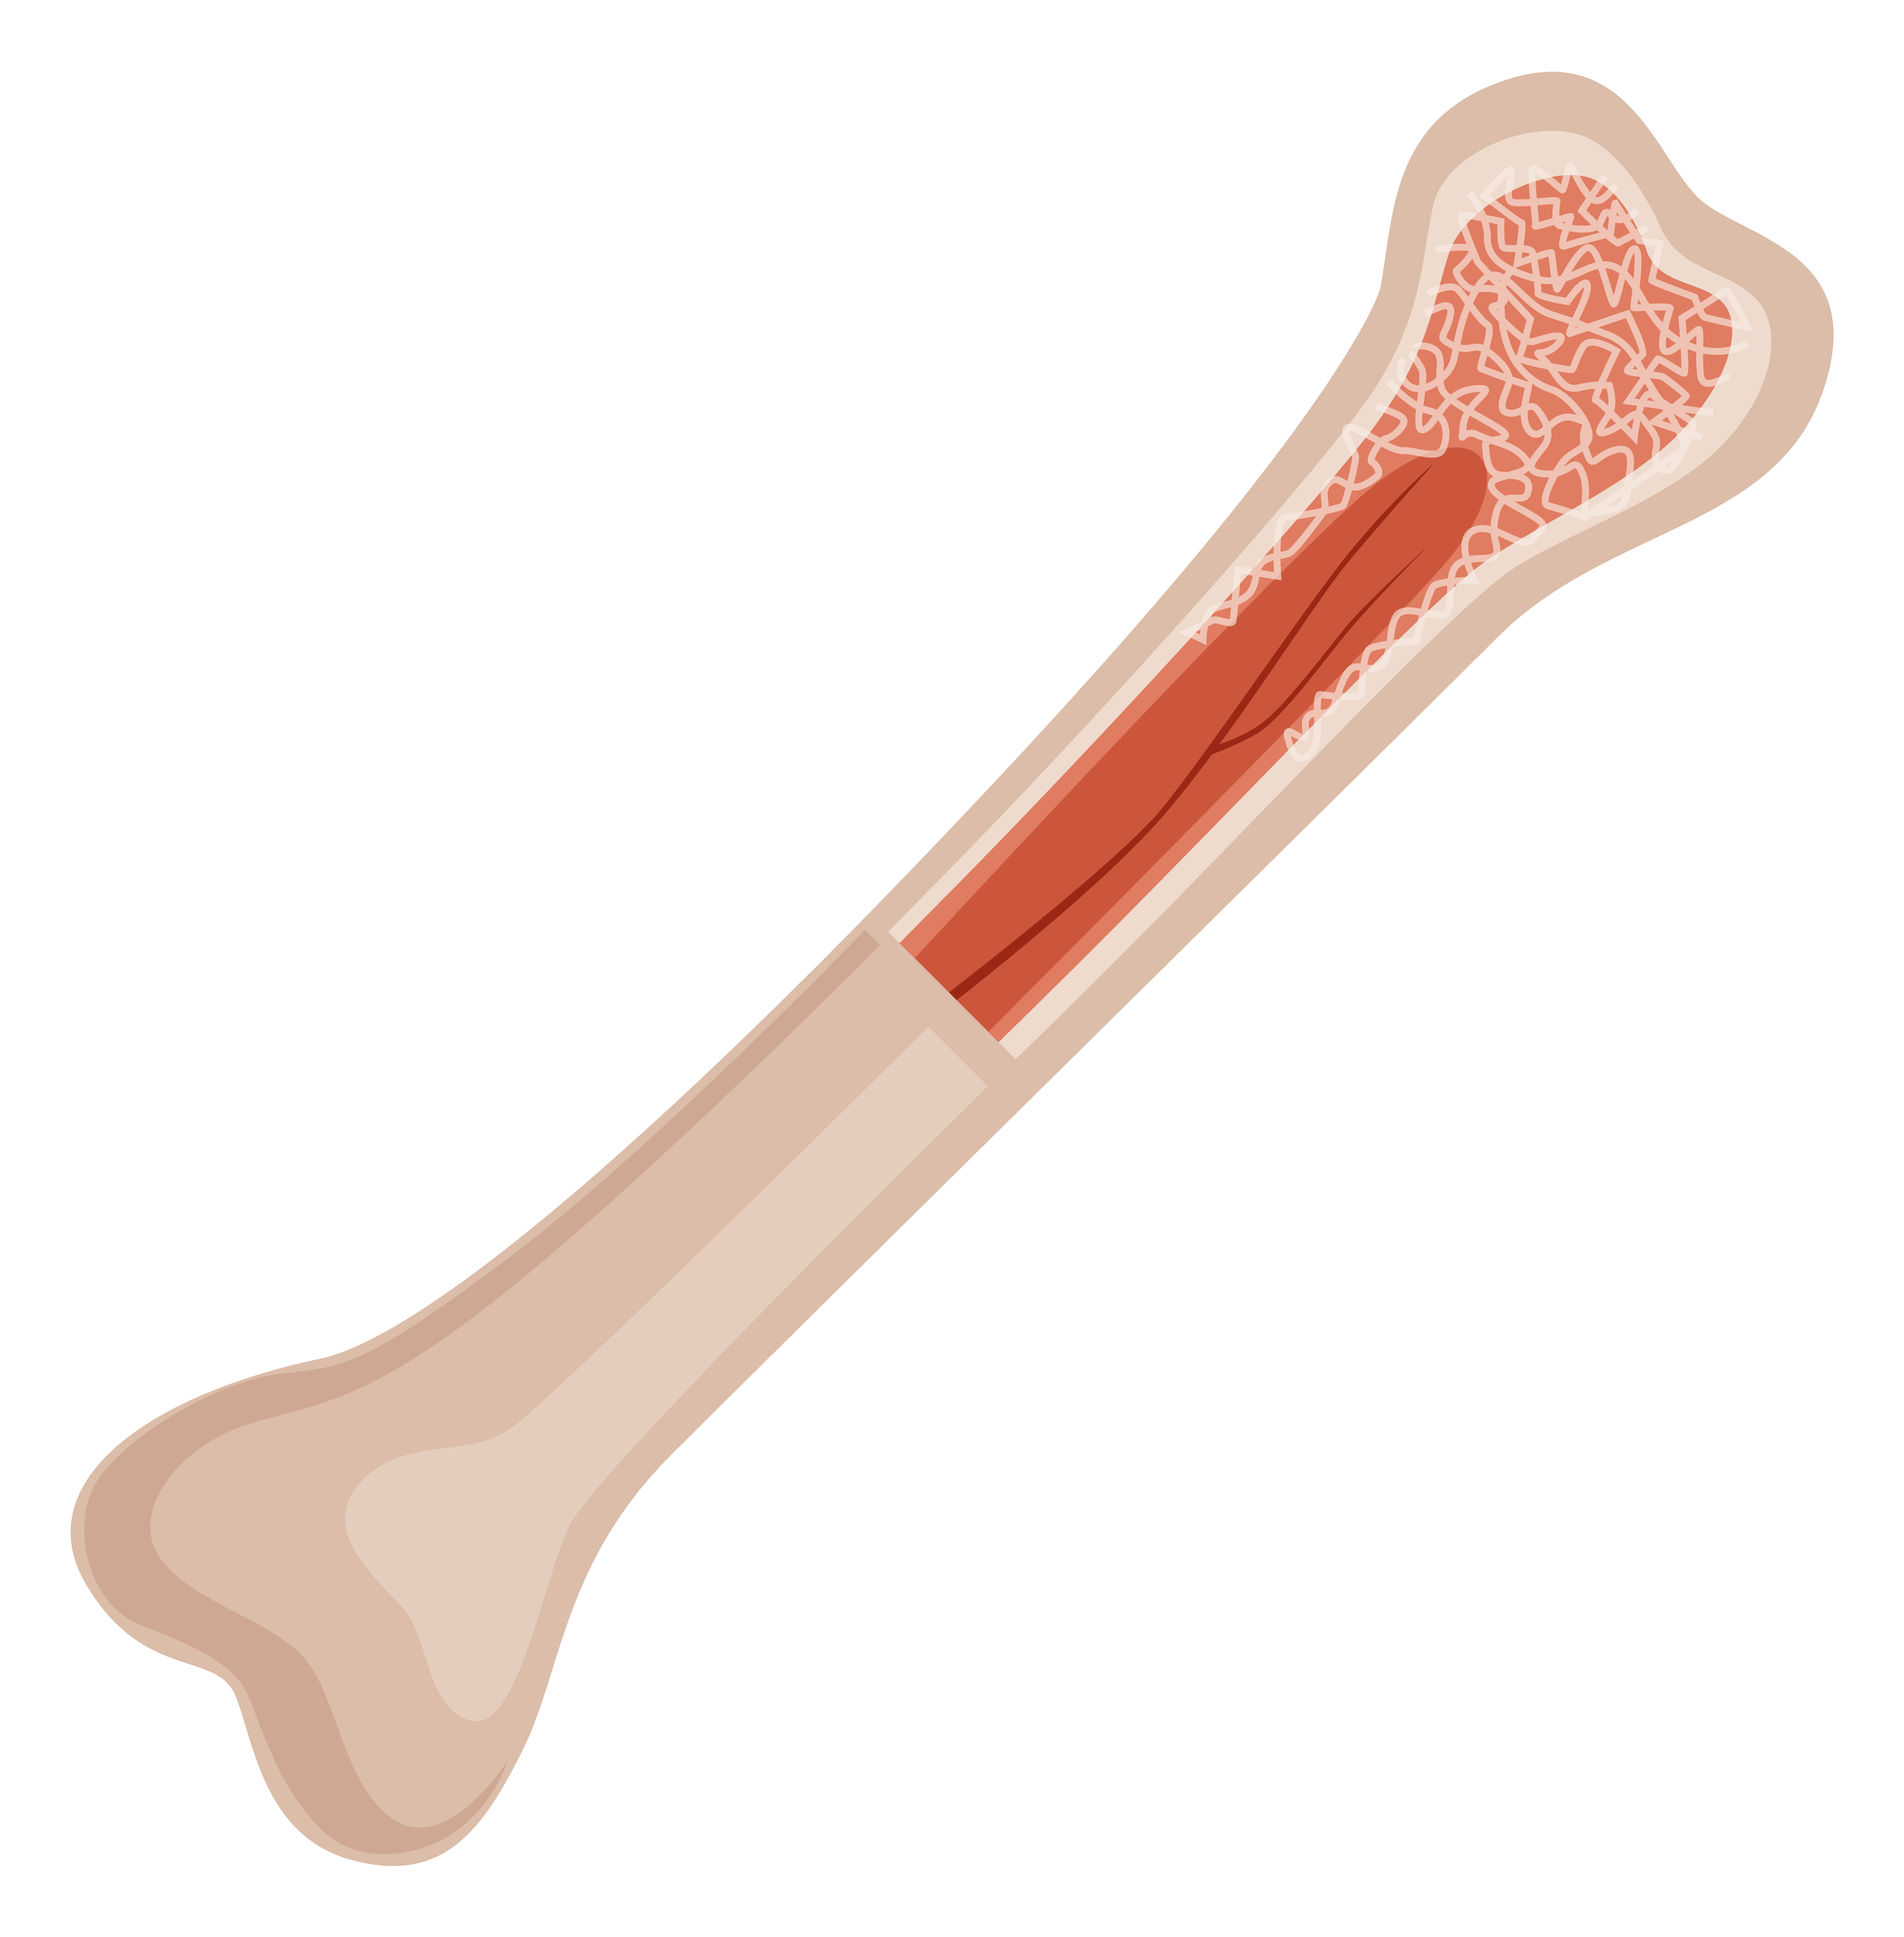
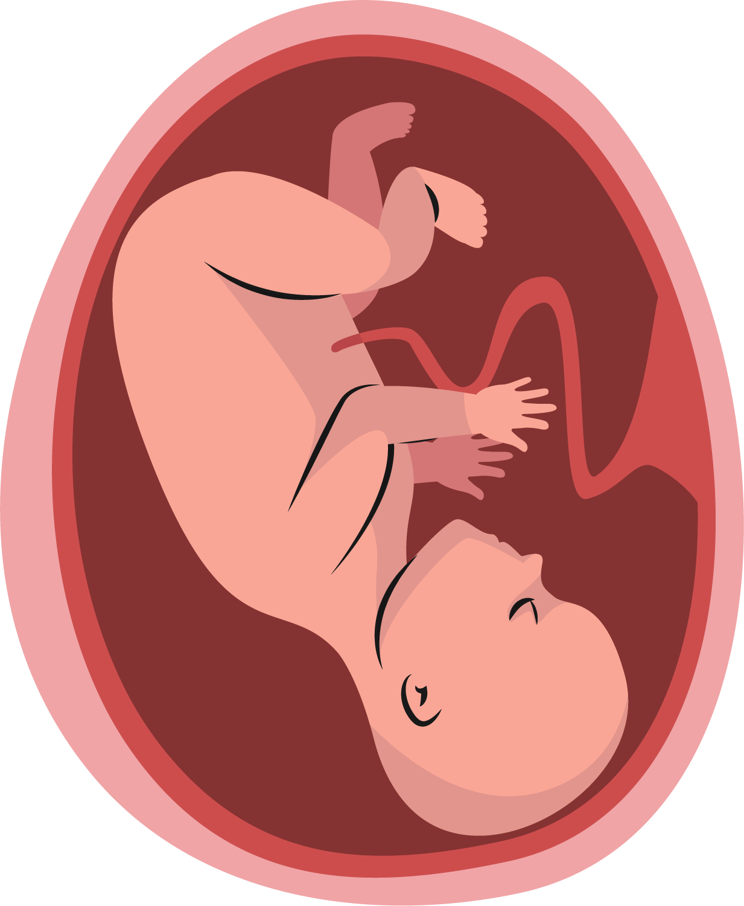
Where are stem cells found?
They are found in bone marrow, which is a soft, jelly-like tissue that fills the inside of your bones.
Stem cells are also found in the umbilical cord of newborn babies.
Notes:
NOTES FOR THE TEACHER
Read the information on the slide with the students. (The same information is provided on p. 4 of the Student Workbook.)

Slide 7
Is a stem cell transplant a simple procedure?
No! For a stem cell transplant to work, the donor’s cells must match the cells of the person who has an illness.
Possible solution: Use science to create a saviour baby that would have matching stem cells and no serious illnesses.
Notes:
NOTES FOR THE TEACHER
Read the information on the slide with the students. (The same information is provided on p. 4 of the Student Workbook.)
Continue reading from p. 4 of the Student Workbook:
No! For a stem cell transplant to work, the donor’s cells must match the cells of the person who has an illness.
The chances are quite low:
There’s about a one in four chance that a family member is a match.
There’s up to a one in 750,000 chance that a person in the general population is a match.
Possible solution: Use science to create a saviour baby that would have matching stem cells and no serious illnesses.

Slide 8
How is a saviour baby created?

Slide 9
Step 1: Several eggs are fertilized in a lab.
What is fertilization?
An embryo is created by fertilization, which is the union of an egg and a sperm cell.
Notes:
NOTES FOR THE TEACHER
Read the information on the slide with the students. (The same information is provided on p. 6 of the Student Workbook.)
Continue reading from p. 6 of the Student Workbook:
What is fertilization?
An embryo is created by fertilization, which is the union of a sperm cell and an egg.
Fertilization usually takes place in the mother's uterus. With today’s scientific advances, however, fertilization can occur in a laboratory. (This is also known as “in vitro fertilization”.) This procedure allows several embryos to be created at the same time.

Slide 10
Step 2: Scientists select the best embryo.
The “best” embryo is the one
whose stem cells are a match for the person who has an illness, and
that doesn’t carry the same disease as the person who has an illness.
Notes:
NOTES FOR THE TEACHER
Read the information on the slide with the students. (The same information is provided on p. 6 of the Student Workbook.)

Slide 11
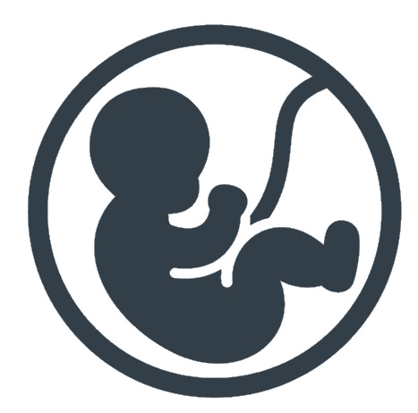
Step 3: The selected embryo is placed in the mother’s uterus.
The “best” embryo is placed in the mother’s uterus.
The pregnancy proceeds normally in the mother’s body until the baby is born.
After the baby is born, the stems cells from its umbilical cord can be used.
Later, the baby can also donate stems cells from its bone marrow.
Notes:
NOTES FOR THE TEACHER
Read the information on the slide with the students. (The same information is provided on p. 6 of the Student Workbook.)

Slide 12
Ethical concerns about prenatal screening
?
?
?
Do you think society should allow prenatal screening?
What are the benefits?
What are the risks?
?
Notes:
NOTES FOR THE TEACHER
Ask students questions to assess their understanding of prenatal screening.
Have students answer the following questions:
Should society allow prenatal screening (to detect if the embryo is carrying certain diseases)?
What are the benefits?
What are the risks?

Slide 13
Is the creation of saviour babies permitted?

Slide 14
In Quebec
Preimplantation genetic diagnosis is only allowed in specific situations.
Using it to create a saviour baby is not allowed.
Using it to select a child’s sex is not allowed.
This image by an unknown author is subject to a CC BY-SA licence.
Notes:
NOTES FOR THE TEACHER
Read the information on the slide with the students. (The same information is provided on p. 7 of the Student Workbook.)
Continue reading from p. 7 of the Student Workbook:
Embryos can be examined (screened) before they’re implanted in the mother’s uterus. This is called “preimplantation genetic diagnosis”.
In Quebec, preimplantation diagnosis is limited to specific cases. It can’t be used to screen the embryo for its immunological compatibility in order to create a saviour baby.
Preimplantation diagnosis to select a child’s sex is not allowed either.

Slide 15
Elsewhere in the world
Different countries have different rules, and they’re changing rapidly.
Notes:
NOTES FOR THE TEACHER
Read the information on the slide with the students. (The same information is provided on p. 7 of the Student Workbook.)
Continue reading from p. 7 of the Student Workbook:
Different countries have different rules, and they’re changing rapidly.
In 2024, several countries allow embryo selection to create saviour babies, for example:
France (total of 9 saviour babies, according to statistics from January 2021)
Belgium (total of 35 saviour babies born, according to statistics from 2013)
United Kingdom
Spain
Portugal
Switzerland (Embryo selection to create saviour babies was previously prohibited by law, but the law was amended in 2017 following a referendum. A referendum is when the population votes on an issue.)
Other countries don’t allow embryo selection to create saviour babies, for example:
Germany
Austria
Japan
Ireland
Italy

Slide 16
Drafting a bill!

Slide 17
Background information
You are members of the National Assembly of Quebec. You and your colleagues must decide how the law should regulate the issue of saviour babies.
Next steps:
Debate on two questions concerning saviour babies.
Divide into small teams and draft clauses of the bill that reflect your beliefs (Questionnaires #1 and #2).
Cont.
Notes:
NOTES FOR THE TEACHER
Read the information on the slide with the students. (The same information is provided on p. 8 of the Student Workbook.)

Slide 18
Background information
Next steps (cont.):
Present all the bills, then choose one for the class project.
Recommend changes to the clauses of the chosen bill. You can also add or remove clauses.
As a class, vote on the various clauses proposed to create the final bill.
Notes:
NOTES FOR THE TEACHER
Read the information on the slide with the students. (The same information is provided on p. 8 of the Student Workbook.)

Slide 19
Making your decisions
You must answer two main questions:
Should the law allow embryo selection?
Should the law allow organ and tissue donations from a child?
Notes:
NOTES FOR THE TEACHER
Explain the background information and the next steps to the students. (The same information is provided on p. 8 of the Student Workbook.)

Slide 20
1. Should the law allow embryo selection?
Notes:
NOTES FOR THE TEACHER
Read p. 9 in the Student Workbook.
Students complete Questionnaire #1 individually (Student Workbook, pp. 10 and 11).
Clarify some of the issues the students are raising. However, avoid debating these issues since they’ll have an opportunity to do so when drafting their bill.
Some of the questions for reflection, especially those on p. 9 of the Student Workbook, could give rise to serious ethical dilemmas for students. Provide time for discussion of these questions after the bill has been drafted.

Slide 21
Drafting the first bill
Procedure:
Complete Questionnaire #1 individually.
Debate the main question as a class.
Divide into small teams and write a bill that includes several clauses reflecting your beliefs.
Each team presents their bill.
Cont.
Notes:
NOTES FOR THE TEACHER
Explain the procedure for drafting the bill for the first question: “Should the law allow embryo selection?” (Student Workbook, p. 12)
As a class, debate the first main question from Questionnaire #1.
Divide students into small teams to write a bill that includes several clauses reflecting their beliefs. (Student Workbook, pp. 13 and 14)
Ask teams to briefly present their bill.

Slide 22
Drafting the first bill
Procedure (cont.):
Choose one of the bills for the class project.
Recommend changes to the clauses of the chosen bill. You can also add or remove clauses.
As a class, vote on the various clauses proposed to create the final bill.
Notes:
NOTES FOR THE TEACHER
Choose a bill from one team to be used as the class bill. (Use visual support to show the class bill.)
Allow students to suggest changes to the class bill. They can also add or remove some clauses.
As a class, vote on the various clauses proposed to develop the final bill.

Slide 23
2. Should the law allow organ and tissue donations from a child?

Slide 24
Which organs and tissues should the law allow a child to donate?
Umbilical cord:
The umbilical cord is always cut when a baby is born. Afterwards, the umbilical cord is no longer of any use to the baby.
Umbilical cord donations are permitted in Quebec.
Notes:
NOTES FOR THE TEACHER
Read the information on the slide with the students.
Continue reading from p. 15 of the Student Workbook:
The umbilical cord:
The umbilical cord is always cut when a baby is born. Afterwards, the umbilical cord is no longer of any use to the baby.
The umbilical cord doesn’t regenerate (the baby will not grow a new umbilical cord).
The umbilical cord can be frozen for 10 years to preserve the stem cells it contains. After this time, it is discarded.
The umbilical cord can be used for the baby itself, for the baby’s siblings or for any other compatible person.
Stem cells from the umbilical cord can be used to treat a person weighing up to 50 kg.

Slide 25
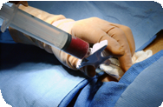
Which organs and tissues should the law allow a child to donate?
Bone marrow:
Surgical procedure
A bone marrow donation involves extracting bone marrow from inside the donor's bone.
Complications during surgery are rare and don’t usually lead to serious consequences.
Cont.
Notes:
NOTES FOR THE TEACHER
Read the information on the slide with the students.
Continue reading from p. 16 of the Student Workbook:
Bone marrow: Surgical procedure
A bone marrow donation involves extracting bone marrow from inside the donor's bone.
The donor is under anesthesia and doesn’t feel anything.
The doctors insert a needle into a bone (for example, the tibia, below the knee) and then withdraw some bone marrow.
Complications during surgery are rare and don’t usually lead to serious consequences.

Slide 26
Which organs and tissues should the law allow a child to donate?
Bone marrow:
After the procedure
The bone marrow regenerates on its own after the surgery.
The donor doesn’t have to take any medication.
A donor child can return to school the next day.
Notes:
NOTES FOR THE TEACHER
Read the information on the slide with the students. (The same information is provided on p. 16 of the Student Workbook.)
Continue reading from p. 16 of the Student Workbook:
Bone marrow: After the procedure
After waking up from the surgery, the donor may feel pain in the area where the needle was inserted. Other effects of the procedure include nausea, headache, a sore throat and dizziness for a few days.
The bone marrow regenerates on its own after the surgery. The donor doesn’t have to take any medication.
The donor simply needs to eat well and rest.
A donor child can return to school the next day but should avoid sports or physical activity for a week.

Slide 27
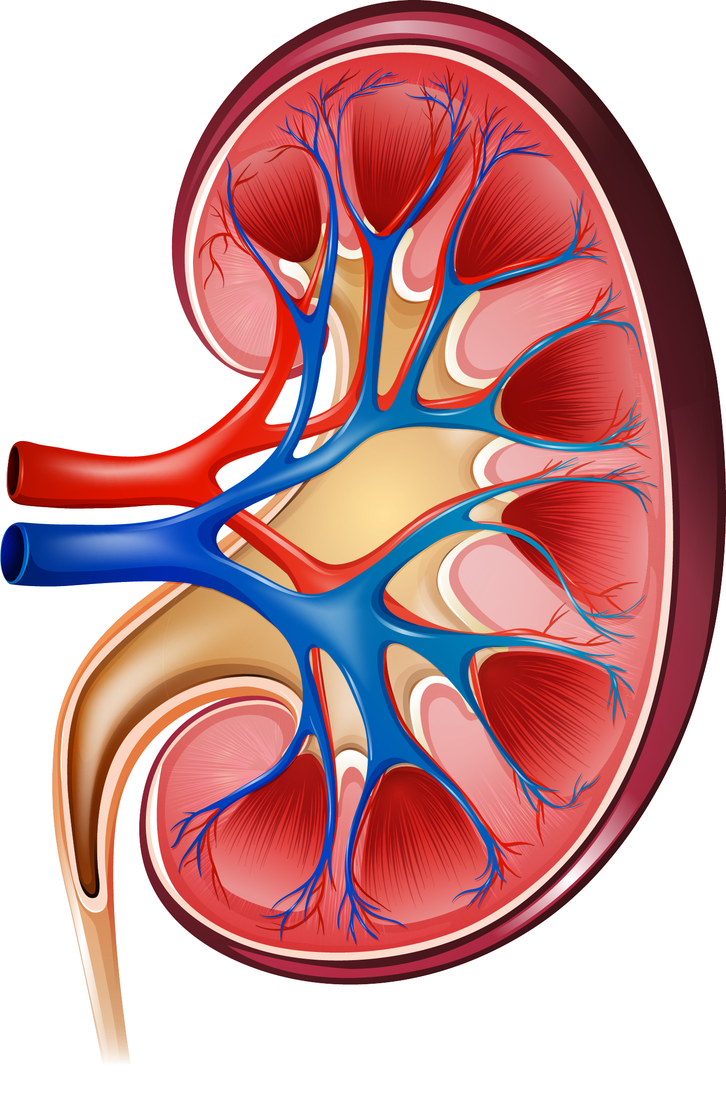
Which organs and tissues should the law allow a child to donate?
Kidney:
Most people are born with two kidneys, but we only need one to survive.
Surgical procedure
Donating an organ such as a kidney requires surgery.
Complications during surgery are rare, but they can be very serious.
Suite
Notes:
NOTES FOR THE TEACHER
Read the information on the slide with the students. (The same information is provided on p. 17 of the Student Workbook.)
Continue reading from p. 17 of the Student Workbook:
Kidney: Most people are born with two kidneys, but we only need one to survive.
Surgical procedure:
Donating an organ such as a kidney requires surgery.
Surgeons make an incision in the patient's abdomen, remove the kidney and stitch up the patient's skin.
The donor is under "general anesthesia" during the operation and doesn’t feel anything. They’ll wake up with a scar.
Complications during surgery are rare, but they can be very serious. Very rarely, the patient doesn’t wake up after surgery.

Slide 28
Which organs and tissues should the law allow a child to donate?
Kidney:
After the procedure
The donor will have to live with only one kidney instead of two. Kidneys do not regenerate.
Complete Questionnaire #2.
3D model
Notes:
NOTES FOR THE TEACHER
Read the information on the slide with the students.
Continue reading from p. 17 of the Student Workbook:
Kidney: After the procedure
The donor will have to live with only one kidney instead of two. Kidneys do not regenerate.
If the person leads a healthy lifestyle, stays hydrated, limits their salt intake (as we all should!) and doesn’t develop a disease that attacks a healthy kidney, they can live well with only one kidney.
Ask students to complete Questionnaire #2 (Student Workbook, p. 15).

Slide 29
Drafting the second bill
Procedure:
Complete Questionnaire #2 individually.
Debate the main question as a class.
Divide into small teams and write a bill that includes several clauses reflecting your beliefs.
Each team presents their bill.
Cont.
Notes:
NOTES FOR THE TEACHER
As a class, debate the second main question from Questionnaire #2. (Student Workbook, p. 18)
Divide students into small teams to write a bill that includes several clauses reflecting their beliefs. (Student Workbook, pp. 19 and 20).
Ask teams to briefly present their bill.

Slide 30
Drafting the second bill
Procedure (cont.):
Choose one of the bills for the class project.
Recommend changes to the clauses of the chosen bill. You can also add or remove clauses.
As a class, vote on the various clauses proposed to create the final bill.
Notes:
NOTES FOR THE TEACHER
Choose a bill from one team to be used as the class bill. (Use visual support so the students can see the class bill.)
Allow students to suggest changes to the class bill. They can also add or remove some clauses.
As a class, vote on the various clauses proposed to develop the final bill.

Slide 31
To learn more . . .
At the end of your Student Workbook, you can learn more about the following topics:
the right to integrity,
free and informed consent,
consent to treatment beginning at age 14,
treatment necessary (or not necessary) to a person’s state of health, and
the rules about organ and tissue donations.
Notes:
NOTES FOR THE TEACHER
Read the information on the slide with the students.
Read the information provided on pp. 21, 22 and 23 of the Student Workbook, either as a class or individually.

Slide 32
Conclusion
Bioethics is a complex field that raises ethical questions concerning life, health and technology.
In this activity, you learned about issues surrounding the conception of saviour babies. Other sensitive topics will probably come up at some point in the future, such as the right to abortion, the moral status of a fetus, surrogacy and human cloning as a source of organs.
We encourage you to find out more about these subjects so you can express your opinion and take part in these important social discussions.
Notes:
NOTES FOR THE TEACHER
Ask students to complete their self-assessment and the concluding questions (Student Workbook, p. 23)
Read the concluding slide.
Discuss students’ final thoughts based on the concluding questions in the Student Workbook p. 24.
Provide additional time to discuss certain questions that give rise to difficult ethical dilemmas.
Complete the optional evaluation.

