Slide 1
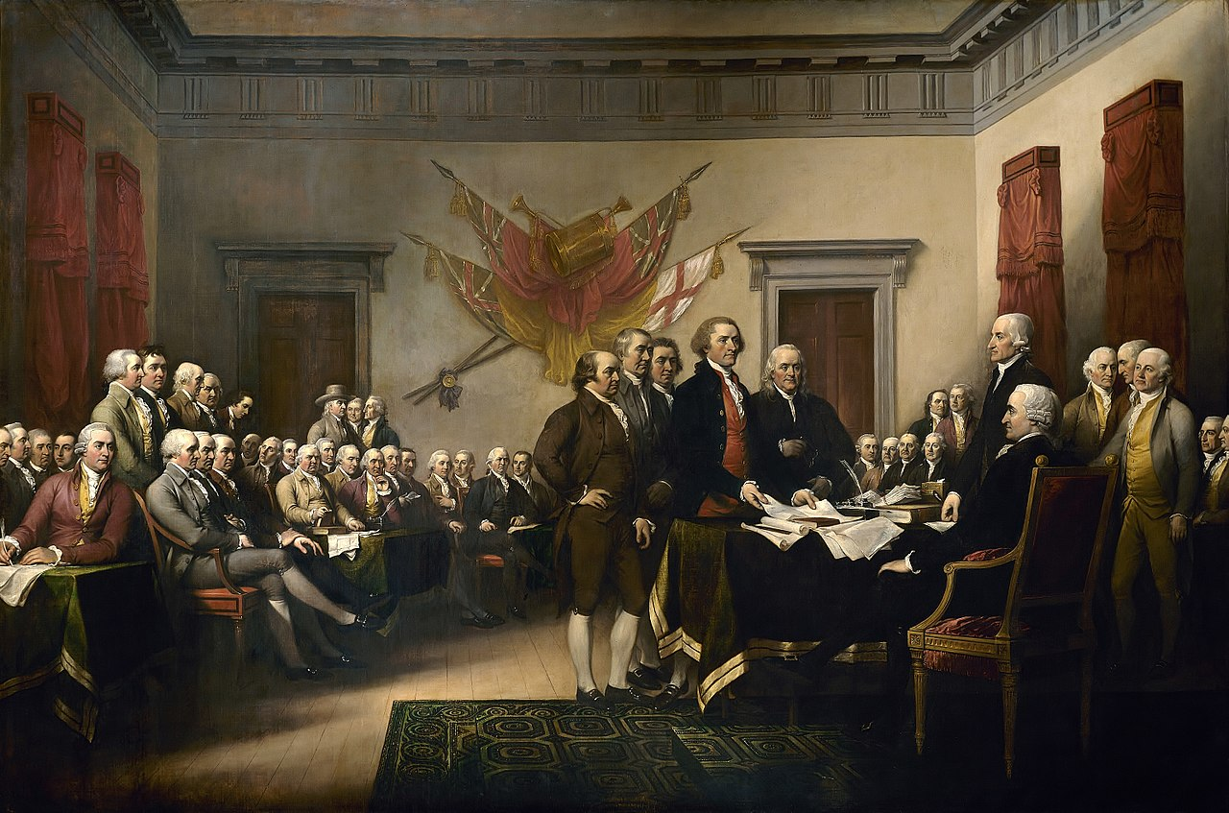
The American Revolution
An overview
Major changes brought about by the Revolution
The Canadian state: influenced by these principles
Notes:
INFORMATION FOR STUDENTS
The symbols on this slide are used throughout this presentation to help students remember the various themes.
The American flag on the slide is sometimes called the ''Betsy Ross‘’ flag, in honour of the woman who designed it. This flag was used between 1777 and 1795. The 13 stars in a circle represent the 13 colonies that revolted against England.
SOURCES:
Image: The Committee of Five presenting their Declaration of Independence to the Congress on June 28, 1776. A painting of John Trumbull, 1819. U.S. Capitol, public domain, https://commons.wikimedia.org/w/index.php?curid=180069

Slide 2
The American Revolution

Slide 3
The Enlightenment
Englightenment Philosophers
Locke: "The necessity of pursuing happiness is the foundation of liberty." Rousseau: "Money we have gives us freedom; money we pursue enslaves us.“ Voltaire: "The more enlightened men are, the more free they are."
Natural Rights
The right to life: Human life is valuable, regardless of a person’s social status or wealth. The right to property: to have your own belongings, furniture, property (house, money, etc.) The right to liberty: a fundamental right to freedom of thought, movement and expression
Underpin the existence of …
Notes:
INFORMATION FOR STUDENTS
Enlightenment philosophers promoted ideals of freedom that became a driving force of the French Revolution. Their publications were very popular with the bourgeoisie and helped change the conception of the individual. This new vision and its ideas about individual freedoms and free will was very different from the pre-Revolution society of the learned bourgeoisie. Most of the leaders of the Revolution did their best to build a more just society in which most people enjoyed individual rights (right to life, property and liberty). (Some people, such as prisoners or people in a state of servitude, did not benefit from these rights.)
Sources :
All historical quotes are taken from: dicocitations.lemonde.fr/. Any translations are Éducaloi’s.
Encyclopédie Larousse, « siècle des Lumières », on line: ˂ https://www.larousse.fr/encyclopedie/divers/si%C3%A8cle_des_Lumi%C3%A8res/130660 ˃ (consulted December 14, 2020)
The various rights are also discussed in slide 10.
The equivalent rights in Quebec: Civil Code of Quebec, CQLR, c C-1991, ss 900, 905 and 947:
947. ”Ownership is the right to use, enjoy and dispose of property fully and freely, subject to the limits and conditions for doing so determined by law.
Ownership may be in various modalities and dismemberments.”
900. “Land, and any constructions and works of a permanent nature located thereon and anything forming an integral part thereof, are immovables. [….]”
905. ”Things which can be moved are movables.”
See also Quebec’s Charter of Human Rights and Freedoms, CQLR c-12, art. 1 : ”Every human being has a right to life, and to personal security, inviolability and freedom.
He also possesses juridical personality.”

Slide 4
The American Revolution: an Overview
Causes
To cover the cost of the Seven Years’ War, England imposed heavy taxes without consulting the United States: Sugar Act (1764) Stamp Act (1765) Tea Act (1773)
Timeline of Events:
1756-1763:
Seven Years’ War
1764- 1773:
Various taxes imposed
1775-1783:
War of Independence
Dec. 16, 1773:
Tea dumped into Boston harbour
(Boston Tea Party)
July 4, 1776:
Declaration of Independence
1787:
The American Consitution comes into force
Notes:
INFORMATION FOR STUDENTS
Ask students how taxes imposed by the English could have become an important trigger for the American Revolution.
Possible answers:
Inhabitants of the 13 colonies felt it was unjust that England imposed taxes on them. The inhabitants had no official channel to express their opinion and were not consulted, even regarding decisions that affected them directly.
This frustration gave rise to a slogan that is now closely associated with the American Revolution: no taxation without representation.
The Seven Years’ War: (Known to Americans as the French and Indian War): Many historians consider this as the first global conflict since it took place on three continents and at sea. England and its allies (Prussia and Hanover) fought against France and its allies (Austria, Sweden, Saxony, Russia and Spain) for control over commerce. It was during this conflict that England gained control of New France.
Taxation: England ended up with a large debt as a result of the Seven Years’ War. England tried to compensate by imposing a number of taxes on the 13 colonies, including on the sale of certain products (sugar and stamps), and on the certain imports (tea, glass, lead).
Boston Tea Party: People were angry about the taxes. They denounced the situation in pamphlets and newspapers. Opposition groups were formed. One of these groups was the Boston Tea Party. July 16, 1773, a group of 50 people disguised themselves as Native Americans and threw a shipment of tea of the East India Company overboard. This was a pivotal moment in the tensions between the colonists and the English government.
War of Independence: Tensions continued to moount between the American patriots and English rulers. It was on April 19,1775, during the Battle of Concord and Lexington, that the first shots were fired. On March 17, 1776, the British retreated from Boston. The war officially ended on September 3, 1983 with the Treaty of Paris, which recognized the independence of the United States.
Declaration of Independence: Just one year after the first shots were fired, the Congress adopted the Declaration of Independence. It was at this point that the U.S. was considered an independent country.
American Constitution comes into force: The first years of the United States as an independent country were marked by tenstions between the states because the central federal government had little authority over the states. The Congress held a constitutional convention in 1787 to create a constitution for the United States. This constitution created a stronger federal government and a clear separation of the three branches of government.
Sources :
The Canadian Encyclopedia, The Seven Years’ War, https://www.thecanadianencyclopedia.ca/en/article/guerre-de-sept-ans, (Consulted January 26, 2021)
Oxford Research Encyclopedias, American History, Print, the Press, and the American Revolution
Lillian Goldman Law Library Online, Great Britian : Parliament - The Townshend Act, November 20, 1767, https://avalon.law.yale.edu/18th_century/townsend_act_1767.asp (Consulted January 26, 2021)

Slide 5
Major changes brought about by the Revolution

Slide 6
Creation of a Modern State: The Separation of Powers
The legislative power
The executive power
The judicial power
Notes:
INFORMATION FOR STUDENTS
States are made up of three branches for creating, applying and interpreting laws. We’ll look at each separately.
This concept was introduced for the first time by the philosopher Montesquieu, who saw the separation of powers as a way to counter absolutism.
To understand the three branches, or powers, we can think of a team sport like hockey. The slides that follow use pictograms to help make a comparaison between the creation of laws and a hockey match.
SOURCES
Henri BRUN, Guy TREMBLAY et Eugène BROUILLET, Droit constitutionnel, 6e éd, Éditions Yvon Blais, Cowansville, 2014, par. II.131, II.76, VI-2.22 and VI-2.23
Nicole DUPLÉ, Droit constitutionnel : principes fondamentaux, 3e éd., Wilson et Lafleur, Montréal, 2014, p.53
Nicole DUPLÉ, Droit constitutionnel : principes fondamentaux, 3e éd., Wilson et Lafleur, Montréal, 2014, p.55 last paragraph
Encyclopédie Larousse, Charles de secondat, baron de La Brède et de Montesquieu, on line: www.larousse.fr/encyclopedie/personnage/Charles_de_Secondat_baron_de_La_Br%C3%A8de_et_de_Montesquieu/133812 (consulted December 2, 2020)

Slide 7
1. Legislative Power
Drafts laws
Decides the rules of the game
Notes:
INFORMATION FOR STUDENTS
When you want to play a game, the first thing to do is to invent the rules. Hockey is no different. If you play in a league, you know that the rules are created by the league. For example, some kinds of physical contact might not be allowed. For players in the National Hockey League, that league decides the rules.
When it comes to government, the power to decide the rules is called the legislative power. This is the power to create laws. Sometimes it is called the power to legislate. We call people who make the laws legislators. These words come from the Latin word lex, which means law.
The legislative branch is the first branch of the state.
SOURCES
Perspective Monde, Pouvoir législatif, École de politique appliquée, Université de Sherbrooke, on line: https://perspective.usherbrooke.ca/bilan/servlet/BMDictionnaire?iddictionnaire=1629#:~:text=Le%20pouvoir%20l%C3%A9gislatif%20(synonyme%20%3A%20branche,pouvoir%20judiciaire%20(les%20tribunaux).&text=G%C3%A9n%C3%A9ralement%2C%20les%20projets%20doivent%20%C3%AAtre,%C3%89tat)%20pour%20devenir%20des%20lois
(consulted January 7, 2021).
Henri BRUN, Guy TREMBLAY et Eugène BROUILLET, Droit constitutionnel, 6e éd, Éditions Yvon Blais, Cowansville, 2014, par. II.84-II.88.

Slide 8
2. Executive Power
Implements laws
Plays hockey and tries to win
Notes:
INFORMATION FOR STUDENTS
Once the rules are in place, we can play. We put on our hockey equipment, grab a puck and we’re off! The purpose of the game – the mission of the players – is to score points and win.
To win you need a strategy. The coach decides which players to play and the captain and players decide on techniques to score goals.
In a political system, the power to implement rules is called the executive power. It’s the power to use laws to reach a goal. For example:
A law can give the government the mission to create three hospitals in the province, but without saying where. The government decides where to put them.
A law can give the government the mission to ensure security in the province. The government can set up police forces to ensure security.
We call this power the executive power because it involves executing missions described in laws.
SOURCES
Perspective Monde, Pouvoir exécutif, École de politique appliquée, Université de Sherbrooke, on line: http://perspective.usherbrooke.ca/bilan/servlet/BMDictionnaire?iddictionnaire=1494 (consulted December 2, 2020)
Henri BRUN, Guy TREMBLAY et Eugène BROUILLET, Droit constitutionnel, 6e éd, Éditions Yvon Blais, Cowansville, 2014, par. II.95-II.99
Creating a hospital: Act respecting health and social services, CQLR c S-4.2, ss 431 and 437
Ensuring public security: Civil Protection Act, CQLR c S-2.3, s 88 (power to declare a state of emergency), s 123 (power to make rules to protect the public), s 67 (powers of the minister of public security). Police Act, CQLR P-13.1, ss. 48, 49 and 112 to 114 (organization of police forces )

Slide 9
3. Judicial Power
Il interprète la loi pour déterminer si une personne la enfreinte (les juges exercent ce pouvoir)
Il est l’arbitre, qui tente d’appliquer les règles du mieux possible
Notes:
INFORMATIONS À TRANSMETTRE AUX ÉLÈVES
Même si les joueurs connaissent les règles du jeu, il arrive qu’ils commettent des fautes dans le feu de l’action. L’arbitre a le pouvoir de décider si le comportement d’un joueur enfreint une règle du jeu et de sanctionner les fautes.
Le pouvoir de sanctionner les personnes qui ne respectent pas les règles du jeu, dans le système politique, s’appelle le pouvoir judiciaire. C’est le pouvoir d’interpréter les lois pour décider si une personne a ou non violé ces lois. Ce pouvoir est exercé par les juges.
SOURCES
Perspective Monde, Pouvoir judiciaire, École de politique appliquée, Université de Sherbrooke, en ligne : https://perspective.usherbrooke.ca/bilan/servlet/BMDictionnaire?iddictionnaire=1637 (consulté le 7 janvier 2021).
Henri BRUN, Guy TREMBLAY et Eugène BROUILLET, Droit constitutionnel, 6e éd, Éditions Yvon Blais, Cowansville, 2014, par. II.89-II.94.

Slide 10
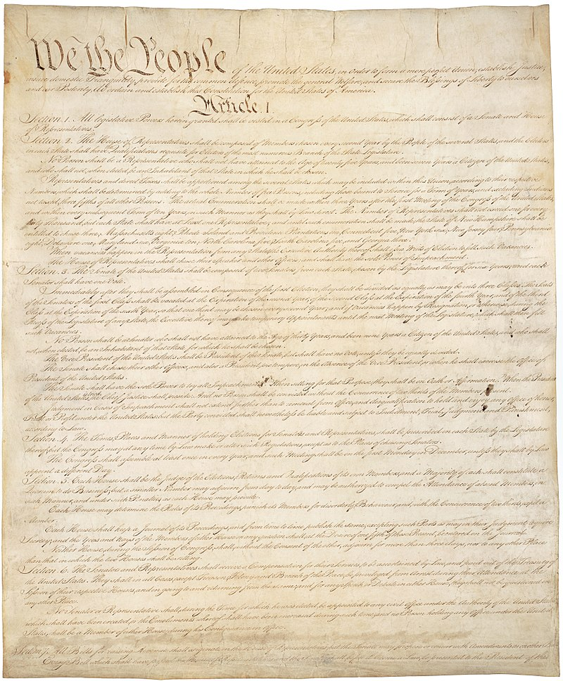
Mise en place d’une constitution
Une constitution, qu'est-ce que c'est?​
C'est la loi suprême d'un pays. Elle indique : ​
​
Le mode de fonctionnement du gouvernement​
Les droits fondamentaux des citoyens​
​Une loi allant à l'encontre de la constitution ne peut être mise en place.​
Notes:
INFORMATIONS À TRANSMETTRE AUX ÉLÈVES
Le 21 février 1787, les représentants des 13 États (anciennes 13 colonies) se regroupent à Philadelphie afin de travailler sur un projet de constitution. Ces représentants discutent et débattent de plusieurs sujets, par exemple le pouvoir que devrait avoir le gouvernement fédéral par rapport à ceux des États (taxation, législation, etc) fait difficilement l'unanimité.
Dans la constitution américaine, on retrouve :
Les modalités de la séparation des pouvoirs vues plus tôt.
Le fonctionnement des deux chambres du congrès (sénat et chambre des représentants)
Le mode de gouvernement : républicain (une république est un pays dirigé par un président élu, généralement démocratiquement).
Sources :
Perspectives monde, Université de Sherbrooke : Nature de l'État, La république. https://perspective.usherbrooke.ca/bilan/servlet/BMDictionnaire?iddictionnaire=1536 [consulté le 21 août 2020]
Source iconographique :
Page 1 de la constitution des États-Unis By Constitutional Convention - U.S. National Archives and Records Administration, Public Domain, https://commons.wikimedia.org/w/index.php?curid=15795309

Slide 11
Le Bill of Rights - déclaration des droits
La constitution américaine peut être modifiée (amendée) en ajoutant des ''amendements'' à la fin de celle-ci.
Le bill of rights est constitué des 10 premiers amendements à la constitution. Ils énoncent certains droits fondamentaux, par exemple :
Liberté d'expression
Droit à un procès juste
Interdiction des peines cruelles et inhabituelles
Notes:
INFORMATIONS À TRANSMETTRE AUX ÉLÈVES
Voici la nature des 10 amendements inclus dans le Bill of rights :
1. Protège la liberté d'expression
2. Protège le droit de porter des armes
3. Interdit le cantonnement forcé des soldats en temps de paix.
4. Interdit les perquisitions et saisies déraisonnables.
5. Protège le droit à une procédure juridique régulière, interdit la double incrimination et autorise la non auto-incrimination (pleading the fifth)
6. Assure divers droits relatifs au processus judiciaire et aux procès (équitable, public, rapide, etc)
7. Droit aux procès avec jury.
8. Interdit les amendes excessives, ainsi que les peines cruelles et inhabituelles.
9. Traite des droits des personnes non expressément énumérés dans la Constitution
10. Limite les pouvoirs du gouvernement fédéral à ceux qui lui sont délégués par la Constitution.
Aujourd'hui, la constitution américaine compte 27 amendements, dont le plus récent, passé en 1992, empêche les lois touchant les salaires du Congrès de prendre effet avant le début de la session du Congrès suivante.
Sources :
La constitution américaine en ligne, https://www.usconstitution.net/const.html, (consulté le 31 janvier 2021)

Slide 12
The Modern Canadian State: Inspired by the Same Principles

Slide 13
Separation of the Three Powers
Federal
Quebec
Provinces
Legislative
Executive
Judicial
Legislative
Executive
Judicial
Notes:
INFORMATION FOR STUDENTS
The federal government and the provincial governments in each province have the same three powers (legislative, executive and judicial). The three powers are sometimes called the three branches.
But the federal and provincial governments don’t have the same areas of responsibility.
For example, the federal government is responsible for these things, among others:
the army (there is only one army for all of Canada)
banks (the same money is used all across Canada)
For example, provinces are responsible for these things, among others:
hospitals
schools
SOURCES :
Constitution Act, 1867, 30 & 31 Vict c 3, (U.K.) reproduced in RSC 1985, Appendix II, n°5, arts 91 (7) (15), 92 (7) and 93

Slide 14
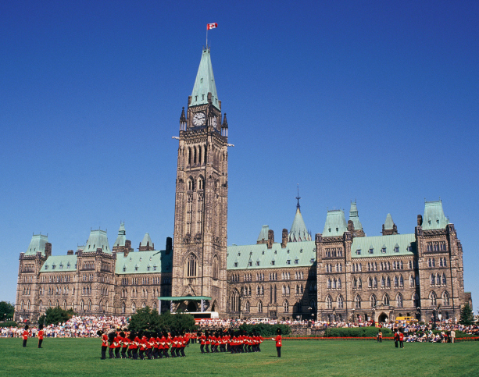
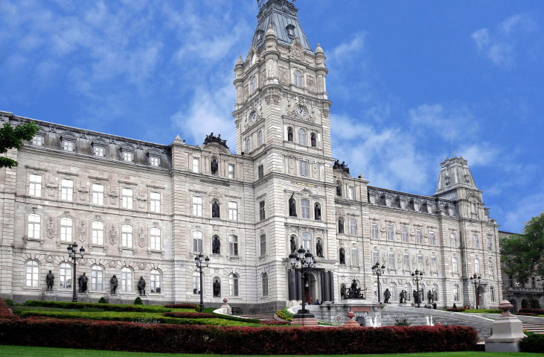
Federal
Quebec
Legislative Power
Legislative Power
Chambre des communes
Assemblée nationale du Québec
+
Sénat
Notes:
INFORMATION FOR STUDENTS
Legislative branch
Creates laws.
The power to legislate is exercised by elected representatives of all the parties. First, laws are drafted. Then the representatives debate and vote on the laws. A draft law becomes an actual law if the majority representatives vote in favour of it.
Canada (federal) Laws are voted on in the House of Commons and in the Senate, which are in Ottawa.
Quebec (province) Laws are voted on in the national assembly in Quebec City.
OPTIONAL INFORMATION
Senate
The Senate is a decision-making body that only exists at the federal level.
Senators are recommended for their positions by the Prime Minister but are formally named by the Governor General.
The main role of the Senate is to study and debate laws proposed by the House of Commons. A proposed law is called a bill. To become a law, a bill must be adopted by both the House of Commons and the Senate and sanctioned (approved) by the Governor General.
In practice, it is very rare for the Senate to refuse to adopt a bill.
One example of this occurred in 1991 when the Senate refused to adopt a bill dealing with abortion, Bill C-43, which arose out of the court case Daigle c. Tremblay.
NOTE TO STUDENTS
For more on the adoption of laws, you can read the article The Process of Passing a Bill on the website of the Canadian Parliament: https://lop.parl.ca/about/parliament/education/ourcountryourparliament/html_booklet/process-passing-bill-e.html (January 7, 2021)
SOURCES
Constitution Act,1867, arts. 17 and 21 and following; 37 and following; 49
Act respecting the National Assembly, CQLR, A-23.1, ss 29-30
Règlement de l’Assemblée nationale, s 219 al.1, p. 256-257 : http://www.assnat.qc.ca/fr/abc-assemblee/fondements-procedure-parlementaire/reglement-assemblee.html
Henri BRUN, Guy TREMBLAY et Eugène BROUILLET, Droit constitutionnel, 6e éd, Éditions Yvon Blais, Cowansville, 2014, par. II.84-II.88 and V-1.273 and following
Perspective Monde, Pouvoir législatif, École de politique appliquée, Université de Sherbrooke, on line : https://perspective.usherbrooke.ca/bilan/servlet/BMDictionnaire?iddictionnaire=1629#:~:text=Le%20pouvoir%20l%C3%A9gislatif%20(synonyme%20%3A%20branche,pouvoir%20judiciaire%20(les%20tribunaux).&text=G%C3%A9n%C3%A9ralement%2C%20les%20projets%20doivent%20%C3%AAtre,%C3%89tat)%20pour%20devenir%20des%20lois. (consulted January 7, 2021).
National Assembly, Bills, The ABC of the National Assembly, on line : www.assnat.qc.ca/en/abc-assemblee/projets-loi.html (consulted January 7, 2021)
Assemblée nationale du Québec, Vote, on line : http://www.assnat.qc.ca/fr/patrimoine/lexique/vote.html (consulted January 7, 2021)
Parliament of Canada, The Process of Passing a Bill, Our Country, Our Parliament, on line: http://lop.parl.gc.ca/About/Parliament/Education/OurCountryOurParliament/html_booklet/process-passing-bill-e.html (consulted January 7, 2021)
Parliamment of Canada, The Senate, Our Country, Our Parliament, on line: http://lop.parl.gc.ca/About/Parliament/Education/OurCountryOurParliament/html_booklet/senate-e.html (consulted January 7, 2021)

Slide 15
Federal
Quebec
Executive
Power
Executive
Power
Governor General
Lieutenant Governor
+
+
Prime Minister
Premier
+
+
Ministers
Ministers
Notes:
INFORMATION FOR STUDENTS
The executive power implements laws.
The executive power is exercised by the government, that is, the political party that won the election by electing the most representatives. The government, either federal or provincial, is made up of the following:
the prime minister (federal) or a premier (provincial). This person is the head of the government.
a cabinet (federal ) or a council of ministers (provincial). The members of cabinet or the council are selected by the prime minister (federal) or premier (provincial) from among the elected representatives.
The government’s mission is to run public services (departments), police forces, the army, etc.
OPTIONAL INFORMATION
Present the political parties in power and the prime minister of Canada and premier of Quebec. This is a chance to introduce some current affairs!
To take it further, you can talk with students about the Governor General and the lieutenant governor.
Gouvernor General and lieutenant governor
The head of state of Canada is the King of England. At the federal level he is represented by the Governor General, and in each province by a lieutenant governor.
Given their symbolic and historic roles, the Governor General and lieutenant governors are rarely involved in significant political or judicial affairs. Their role is mostly to approve certain decisions made by the State. For example, they must approve bills (proposed laws) so they can become law.
SOURCES
Constitution Act,1867, arts. 15, 55, 58, 63 and 91(7)
National Defence Act, RSC 1985, c. N-5, ss 3 and following
Executive Power Act, CQLR, c. E-18, ss 4 and 9
Government Departments Act, QCLR, c. M-34, s 1
Salaries Act, RSC 1985, c. S-3, s 4.1.
Henri BRUN, Guy TREMBLAY et Eugène BROUILLET, Droit constitutionnel, 6e éd, Éditions Yvon Blais, Cowansville, 2014, par. II.95-II.99 / V.2.8-V.2.12 / V.2.31-V.2.35 / V-2.40, V-2.47 to V-2.51 / V-2.43, V.247 / IX.178, IX.183 and following.
Perspective Monde, Pouvoir exécutif, École de politique appliquée, Université de Sherbrooke, on line: http://perspective.usherbrooke.ca/bilan/servlet/BMDictionnaire?iddictionnaire=1494 (consulted January 7, 2021)
Eugene A. FORSEY, How Canadians Govern Themselves, 6.4 Political Parties, Website of the Parliament of Canada, on line: www.bdp.parl.gc.ca/About/Parliament/SenatorEugeneForsey/book/chapter_6-e.html (consulted January 7, 2021)
Parliament of Canada, Canadian Parliamentary Institutions, The Executive, on line: https://www.ourcommons.ca/About/ProcedureAndPractice3rdEdition/ch_01_2-e.htm (consulted January 7, 2021)
Parliament of Canada, Overview of the Canadian Parliamentary System, Our Country, Our Parliament , on line: http://lop.parl.gc.ca/About/Parliament/Education/OurCountryOurParliament/html_booklet/overview-canadian-parliamentary-system-e.html (consulted January 7, 2021)

Slide 16
Federal
Quebec
Judicial Power
Judicial Power
Courts
Courts
Notes:
INFORMATION FOR STUDENTS
The judicial branch makes decisions about conflicts. This power is exercised by the courts and therefore by judges. The courts must be neutral and separate from the legislative and executive branches.
Judges make decisions on conflicts between citizens, for example, two neighbours disagreeing about the placement of a fence. To ensure fair decisions, judges must decide based only on the law. So, for example, the judge cannot be related to one of the neighbours and decide in favour of that person. We say that judges must be impartial.
Judges also make decisions on conflicts between citizens and the State. The conflict could be, for example, a citizen who thinks the police entered his or her home by force without having the right to. Judges must be free to decide that the State acted improperly without fearing the consequences of this kind of decision. So, judges can’t lose their salaries or be fired because of a decision the State did not like. We therefore say that judges must be independent.
Judges are therefore both impartial and independent.
Of course, judges don’t decide on conflicts any which way they like: they must decide based on the law. We sometimes say that they interpret laws, which are not always easy to understand, and that they make legal rulings. They usually have to write down their decisions in a “judgment” that explains their reasoning.
The highest court in Canada is the Supreme Court.
SOURCES
Supreme Court Act, RSC 1985, c S-26, ss 3 and 52
Henri BRUN, Guy TREMBLAY et Eugène BROUILLET, Droit constitutionnel, 6e éd, Éditions Yvon Blais, Cowansville, 2014, par. II.89-II.94, X.125 and following and X.147 and following
Perspective Monde, Pouvoir judiciaire, École de politique appliquée, Université de Sherbrooke, on line: http://perspective.usherbrooke.ca/bilan/servlet/BMDictionnaire?iddictionnaire=1637 (consulted January 7, 2021)

Slide 17
In Canada: Democracy
The government represents the people.
No one is above the law.
The government serves the people.
The government can be held accountable.
Law
Notes:
INFORMATION FOR STUDENTS
The well-being of the people is central in a democracy. Tĥe population makes decisions (because the government is made up of citizens) and must respect government decisions (because no one is above the law).
People can participate freely in decisions that affect them. Here are examples:
vote freely in elections
create newspapers, TV stations or You Tube channels and criticize the government
demonstrate in the street
create political parties or associations to express their views
In democracies, government power is circumscribed by laws. Citizens must also respect laws. When the law is more powerful than the government, we say that the country is governed by the “rule of law.”
For example, in Canada, the law requires that representatives be elected in elections held every four years by universal suffrage and by secret vote. This means that all citizens 18 and over can vote and that their vote is secret.
In Canada, citizens vote for the people who will represent them and take decisions on their behalf.
NOTE: Representative democracy and direct democracy
In our example, we are talking about so-called representative decmocracy, which is the Canadian system.
But there are other forms of democracy. In direct democracy, citizens participate directly in making laws.
SOURCES
Canada Elections Act, LC 2000, c 9, ss 3, 56.1, 163 and 385
Canadian Charter of Rights and Freedoms, arts 2 b), c), d) and 3, Part I of the Constitution Act, 1982, Schedule B of the Canada Act 1982 (U.K.), 1982, c 11
Perspective Monde, Suffrage universel, École de politique appliquée, Université de Sherbrooke: http://perspective.usherbrooke.ca/bilan/servlet/BMDictionnaire?iddictionnaire=1526 (consulted January 7, 2021)
Perspective Monde, Démocratie, École de politique appliquée, Université de Sherbrooke : http://perspective.usherbrooke.ca/bilan/servlet/BMDictionnaire?iddictionnaire=1487 (consulted January 7, 2021)
Perspective Monde, État de droit, École de politique appliquée, Université de Sherbrooke : http://perspective.usherbrooke.ca/bilan/servlet/BMDictionnaire?iddictionnaire=1493 (consulted January 7, 2021)
Philippe Parini, Régimes politiques contemporains, Masson, Paris, 1991, pp.105 to 108
Raymond Aron, Démocratie et totalitarisme, Gallimard, Paris, 1965, p.76
Dominique Chagnollaud, Science politique, 2e éd., Dalloz, Paris, 1999, pp. 50, 67 to 69

Slide 18
In Canada: Indirect Democracy
Law
Representative
Citizens
Notes:
INFORMATION FOR STUDENTS
In a direct democracy, citizens vote for or against proposed laws.
In an indirect democracy, like Canada’s, citizens don’t vote directly for or against proposed laws. They vote for a representative, also called a member of the House of Commons (federal) or member of the national assembly (Quebec). The member represents citizens in a certain region. (The region is called a riding.) It is the member who votes for or against proposed laws.
SOURCES
Rémi Bouguet, « Pour une démocratie directe », Éthique publique [on line ], vol. 13, n° 2 | 2011: http://journals.openedition.org/ethiquepublique/753 (Consulted April 29, 2020)
Internation IDEA, Démocratie indirecte - Un aperçu du Manuel d’Internation IDEA, 2008 : https://www.idea.int/sites/default/files/publications/democratie-directe-un-apercu-du-manuel-d-international-idea_1.pdf (Consulted April 29, 2020)
R., POLIN (1997). 4 - Le problème de la représentativité . Dans R. Polin, La République entre démocratie sociale et démocratie aristocratique (pp. 144-152). Paris cedex 14, France: Presses Universitaires de France : https://www.cairn.info/la-republique-entre-democratie-sociale--9782130486985-page-144.htm?contenu=resume (Consulted April 29, 2020)

Slide 19
Majority Government
13 elected representatives of the ORANGE party
Winning Party
Losing Parties
13 > 12 13 > 8
13 > 4
8 elected representatives of the BLUE party
4 elected representatives of the
GREY party
Total: 25 elected representatives
Notes:
INFORMATION FOR STUDENTS
The separation between the legislative and executive power is not always obvious. In the Canadian political system, it is easier to see the separation when the government is a minority government.
This slide gives an example of a party in power with a majority.
The representatives (legislative power) are elected by citizens. The government (executive power) is formed by the party that wins the elections.
In this slide, the orange party won the elections with 13 of 25 elected representatives. This party is therefore in the majority.
The orange party forms the government. The head of this party becomes prime minister (federal) or premier (provincial) and choses representatives to be in the cabinet (federal) or council of ministers (provincial).
The legislative and executive powers are therefore exercised by the same party.
The separation of powers is therefore harder to see: the majority party controls both the executive and the legislative branches. See the next slide for an example of a minority government.
SOURCES
Henri BRUN, Guy TREMBLAY et Eugène BROUILLET, Droit constitutionnel, 6e éd, Éditions Yvon Blais, Cowansville, 2014, par. VII.11
Perspective Monde, Gouvernement minoritaire, École de politique appliquée, Université de Sherbrooke, on line: http://perspective.usherbrooke.ca/bilan/servlet/BMDictionnaire?iddictionnaire=1506 (consulted January 7, 2021)

Slide 20
Minority Government
13 elected representatives of the ORANGE party
Winning Party
Losing Parties
10 < 15 10 > 8
10 > 7
4 elected representatives of the
GREY party
8 elected representatives of the BLUE party
Total: 25 elected representatives
Notes:
INFORMATION FOR STUDENTS
This slide shows an example of a minority government.
The elected representatives (legislative power) are elected by citizens. The government (executive power) is made up of the party that wins the elections.
In the example, the orange party won the elections with a very small lead. It got 10 representatives. The blue party got 8 and the grey party 7.
The blue and grey parties together have more than the orange party. In this situation, we say there is a minority government, because no one has an absolute majority.
In other words, the winning party (orange party) exercises the executive power by forming the government, but the losing parties, if they get together, can block laws they don’t agree with. They therefore have a certain degree of control over the legislative power.
The separation of powers between the executive power (orange party) and the legislative power (coalition of the blue and grey parties) is clearer. To pass laws, the orange party must collaborate with the oher parties.
SOURCES
Henri BRUN, Guy TREMBLAY et Eugène BROUILLET, Droit constitutionnel, 6e éd, Éditions Yvon Blais, Cowansville, 2014, par. VII.11
Perspective Monde, Gouvernement minoritaire, École de politique appliquée, Université de Sherbrooke, on line: http://perspective.usherbrooke.ca/bilan/servlet/BMDictionnaire?iddictionnaire=1506 (consulted January 7, 2021)

Slide 21
In Canada: Equality Before the Law
The Canadian Charter of Rights and Freedoms garantees equality before the law.
​
"Every individual is equal before and under the law and has the right to the equal protection and equal benefit of the law without discrimination …. " Art 15 (1)​
Notes:
INFORMATION FOR STUDENTS​
​
What is a charter?
The Canadian Charter is a law, but a special law that is above all other laws. This means that no other laws – federal, provincial or territorial – can contradict the Charter. For example, since the right to equality is guaranteed by the Canadian Charter, legislators could not make a law saying only men can join the army.
An example of a real law that turned out to violate the Charter had to do with marriage: the law said marriage could only take place between a man and a woman. The courts decided that law violated the right of people to be treated equally because it discriminated against same-sex couples. The law was changed so they could marry.
The Canadian Charter of Rights and Freedoms
The Charter was adopted in 1982, as the first part of the Canadian Constitution. As its name suggests, it protects certain rights and freedoms of Canadians.
Here are examples of freedoms protected by the Charter:
freedom of conscience and religion
freedom of thought, belief and expression
freedom of association
freedom of movement and freedom to take up residence in any province
Here are examples of rights guaraneed by the Charter:
right to life, liberty and security of the person
right to protection against arbitrary imprisonment
right to vote
Canadian Charter of Rights and Freedoms: https://laws-lois.justice.gc.ca/eng/const/page-15.html
Sources:
Canadian Charter of Rights and Freedoms, Schedule B, Part I, Constitution Act, 1982, art 15 (1)

Slide 22
Debates!

Slide 23
For or against?
Judges should be elected by citizens instead of named by the government.
Notes:
INFORMATION FOR STUDENTS
Advantage: Elected judges would better represent the interests of the population. They would also be more independent of government.
Problem: Elected judges would be tempted to make decisions that pleased voters so they could get elected or re-elected, even if those decisions went against the law. Also, being elected would not ensure their independence: their independence is guaranteed by the fact that the government can’t take away their salaries or fire them.

Slide 24
For or against?
The law should consider people to be adults before age 18.
Notes:
INFORMATION FOR STUDENTS
The “age of majority” –18 – is the age when somene becomes an adult in the eyes of the law. Before 18, people are considered to be “minors.” Minors don’t have the same rights and responsibilities as adults.
However, the law gives some minors certain rights and certain responsibilities:
12 years old: You can be accused of a crime, for example, theft. We say that people become “criminally responsible for their actions” as of this age.
14 years od: You can do things like consult a doctor without permission from parents, work without parental permission and keep money earned from a job.
16 years old: You get more rights. For example, you can marry (if a court agrees), get a driver’s licence or belong to a union.
However, certain things are reserved for adults: the right to vote, to be a candidate in an election, to buy cigarettes and alcohol, to make a will or to go to a casino or buy lottery tickets.
18 might seem like a long ways away. But not so long ago – before 1971 – teenagers had to wait until 21 to legally be an adult in Quebec. And before 1782, the age of majority was 25!
Sources :
Civil Code of Quebec, arts 14 al. 2, 153, 157 and 167 al. 1
Youth Criminal Justice Act, S.C. 2002, c 1, s 2 “young person”
Highway Safety Code, CQLR c C-24.2, s 67
Profesional Syndicates Act, CQLR c S-40 s 7
Election Act, CQLR c E-3.3, s 1
Canada Elections Act, S.C. 2000, c 9, s 3
Tobacco Control Act, CQLR c L-6.2, s 13
Tobacco and Vaping Products Act, S.C. 1997, c 13, ss 2 “young person” and 8(1)
Act rspecting offences relating to alcholic beverages, CQLR c I-8.1, s 103.2
Act respecting the Société des loteries du Québec, CQLR c S-13.1, s 25.1
Convention on the Rights of the Child, art 1
Justice Canada, Important dates in the history of the civil law in Quebec: www.justice.gc.ca/eng/pr-rp/sjc-csj/pji-ilp/hist/

Slide 25
Instagram/educaloi_en
YouTube/educaloi
Facebook/educaloi
educaloi.qc.ca/en

