Slide 1
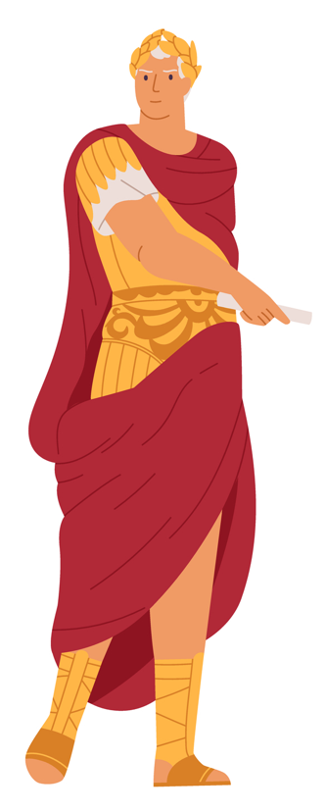
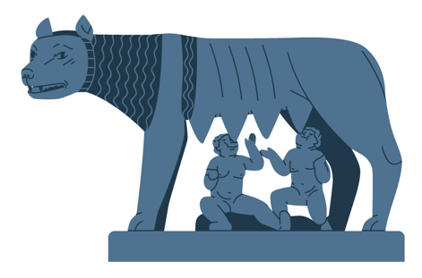
Rome​
Polical organizations
Codes of law
Notes:
NOTE TO TEACHER
This guide is designed to be used in conjunction with the History and Citizenship Education course (Secondary 1).
This PowerPoint presentation focuses on the legal aspects of the chapter entitled Romanization. It comes with the following student comprehension exercises:
The political organization of States:
Monarchy
Republic
Empire
Roman Codes of Law:
The Twelve Tables
The Justinian Code
The influence of Roman law
This presentation contains additional information and supplemental questions for the students if you would like to explore certain subjects in greater depth. Some slides contain a Resources section listing texts or educational materials that you can also share with your students.
There is also a Sources section listing the legal and non-legal sources for the information presented in the slides and in the notes.
Images:
S.P.Q.R. (Senatus populusque romanus) was the motto of the Roman Republic then, later, of the Roman Empire. The motto, originally in Latin, means "For the Roman senate and the Roman people". WikiCommons
Remus and Romulus: By Benutzer:Wolpertinger on WP of — Own book scan from Emmanuel Müller-Baden (dir.), Bibliothek des allgemeinen und praktischen Wissens, I, Deutsches Verlaghaus Bong &amp; Co, Berlin-Leipzig-Wien-Stuttgart, 1904. Image copied from de:Bild:Kapitolinische-woelfin 1b-640x480.jpg, public domain, https://commons.wikimedia.org/w/index.php?curid=190611
Sources (diapo 1-3):
Universalis, « Civilisation Romaine (notions de base) », Encyclopædia Universalis, en ligne: ˂ https://www.universalis.fr/encyclopedie/civilisation-romaine/ ˃ (consulté le 24 novembre 2020), p 2-4 (PDF)
Jean Gaudemet, « DOUZE TABLES, droit romain », Encyclopædia Universalis, en ligne: ˂ http://www.universalis-edu.com/encyclopedie/douze-tables-droit-romain/ ˃ (consulté le 24 novembre 2020), p 1 (PDF)
Jehan de Malafosse, « JUSTINIEN DROIT », Encyclopædia Universalis, en ligne: ˂ http://www.universalis-edu.com/encyclopedie/droit-justinien/ ˃ (consulté 24 novembre 2020), p 1 (PDF)

Slide 2
1. Rome’s first three political organizations :
Monarchy​
Republic​
Empire​
​
2. Ses codes de loi​ :
The Twelve Tables
The Justinian Code
3. Le droit québécois actuel

Slide 3
Three kinds of political organization

Slide 4
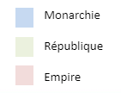
Rome: Monarchy, Republic, then Empire
Beginning of the Roman Republic
509 BCE
Beginning of the Roman Empire
27 BCE
Fall of the Western Roman empire
476 CE
Founding of
Rome
753 BCE
-800
-600
-400
-200
1
200
400
600
Notes:
NOTE TO TEACHER
This timeline shows the three successive political organizations in Rome, from its founding until the fall of the Western Roman Empire.
You could ask the students about the dates on the timeline. If the students are unaware of these events, you can make them appear by clicking rapidly on the screen.
The second code of Roman law presented in this PowerPoint (Justinian Code) dates from after the fall of the Western Roman Empire and is derived from the Eastern Roman Empire. For this reason, students should be aware that the Eastern Roman Empire will continue to exist for nearly a millennium after the fall of Rome, only to fall in 1453. Despite the fact that the city of Rome was not part of the Eastern Roman Empire (known as the Byzantine Empire), this part of the empire perpetuated Roman culture, while still maintaining a rich cultural mix.

Slide 5
A monarchy is....
Monarchy
From the Greek word mono “one” and arkè “power” = “power of one”
A monarchy’s Head of State is called ….
The King or the Queen
Notes:
NOTE TO TEACHER
First, we suggest that you let the students try to answer. Write the answers or keywords given by the students in the grey rectangle. You can then display the etymological explanation of the word.
The concept of monarchy:
In the vast majority of cases, the power of a king or queen is hereditary. This means that the monarch's children or grandchildren will inherit power upon the the king or queen’s death.
Montesquieu’s definition of the term: "A monarchy is defined by the absolute government of one person, but such power is limited by laws." If you have already discussed the definition of "dictatorship" with the students, we suggest that you compare both concepts with them
The Roman monarchy:
The monarchy was the oldest and shortest period of Roman history. It is also the least known.
It was at this time that Rome became a real "city" and developed its own culture.
Source:
Jacques Ellul, « monarchy », Encyclopædia Universalis, en ligne: ˂ http://www.universalis-edu.com/encyclopedie/monarchy/ ˃ (consulté le 24 novembre 2020), p 1 (PDF)

Slide 6
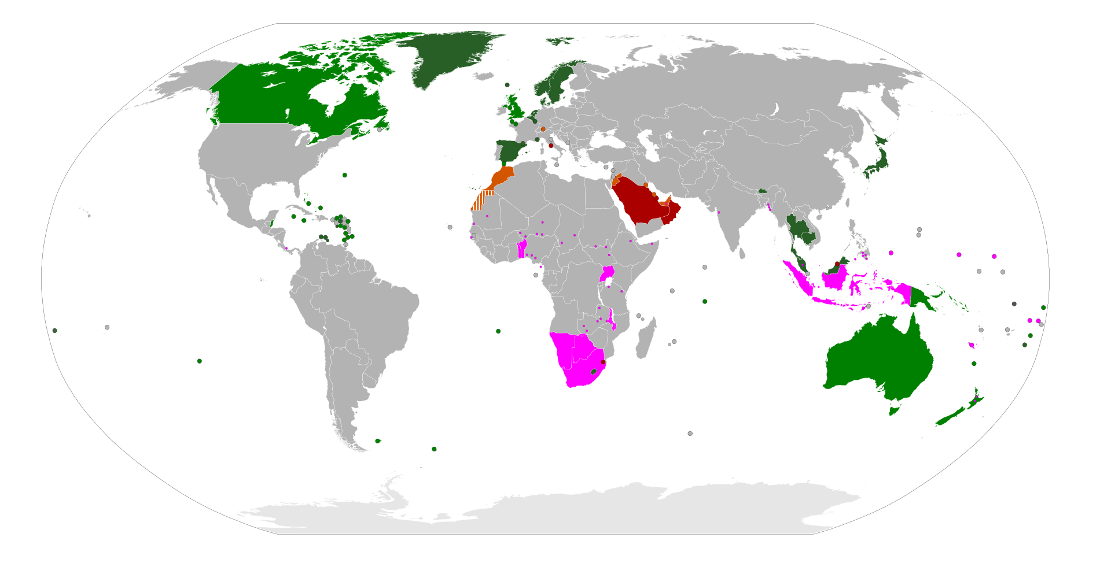
Modern-day monarchies
Absolute monarchies
Constitutional monarchies
Parliamentary monarchies
Traditional monarchies, in some parts of the land
Notes:
NOTE TO TEACHER
The slightly lighter shade of green indicates Commonwealth countries.
Definitions of the types of monarchies shown on the map:
Absolute monarchy : monarchy in which the king or queen holds real and unlimited powers.
Constitutional monarchy: monarchy in which the king or queen have symbolic powers defined by a constitution.
Parliamentary monarchy: A parliamentary monarchy is a form of constitutional monarchy. The most important difference is that in a parliamentary monarchy, it is technically the King or Queen (or their representative, the Governor General in the case of Canada) who appoints the Prime Minister as the head of government.
Traditional monarchies : Such monarchies exist in some parts of certain countries. They often have cultural or historical significance for a particular group of people or minority religion in a particular country. While such monarchies are most often symbolic, they nevertheless play an important role in the spiritual life of a group.
SOURCES:
REID, H. (2010). monarchie absolue, dans Dictionnaire de droit québécois et canadien.
REID, H. (2010). monarchie constitutionnelle, dans Dictionnaire de droit québécois et canadien.
Parlement du Canada, Rôle du monarque. https://lop.parl.ca/about/parliament/education/ourcountryourparliament/html_booklet/role-monarch-f.html [consulté le 21 août 2020]
IMAGE:
Map of the World: WikiCommons By Eddo - Own workFile:World monarchies.png, CC BY-SA 3.0

Slide 7
A republic is …
Republic
Today, a republic’s Head of State is called ...
The president.
Notes:
NOTE TO TEACHER
The concept of republic:
It can be difficult to define the concept of republic. Today, a republic is a country headed by an elected president, the vast majority of the time democratically. However, there are a few exceptions. For example, in the USSR although the president was actually elected, it was by a small group of people who were already part of the ruling class.
Unlike most monarchies, power in a republic is not hereditary. The republic is also a form of political organization in which the laws apply to everybody, without exception
It can be tricky to distinguish between certain political systems. For example, Canada, which is officially a monarchy, is more democratic than many countries described as republics. The distinction thus becomes rather legal: state attorneys represent the Queen (Crown attorneys), and Heads of State elected by the people are sanctioned by the monarch.
Etymology: The term republic comes from the Latin res publica, which means "public thing".
The Roman Republic:
It should be noted that the Roman republic is not a "true" democracy, as we understand that term today. Only a small part of its inhabitants had real political power: patrician men.
Patricians were a kind of Roman aristocracy, since being part of that social group was solely a family matter. If one parent was patrician, so were the children.
Sources:
Le petit Larousse, 2011, republic.
Perspectives monde, Université de Sherbrooke: Nature de l'État, La republic. https://perspective.usherbrooke.ca/bilan/servlet/BMDictionnaire?iddictionnaire=1536 [consulté le 21 août 2020]

Slide 8
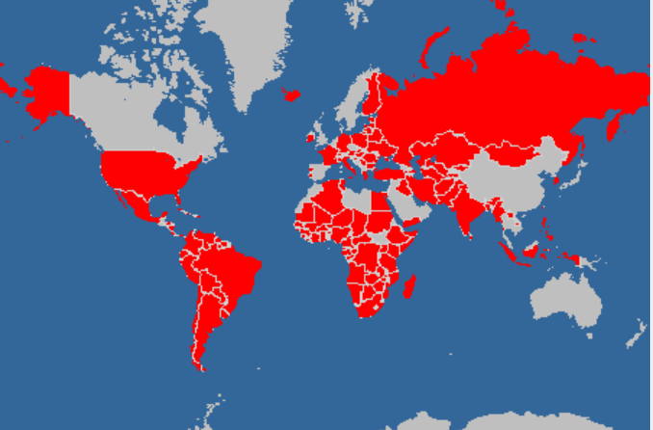
Modern-day republics
The word “republic” is not automatically synonymous with the word “democracy”.
Canada and Spain are both democracies, but they have a queen or king as its (symbolic) Head of State.
Laos is officially a republic, but only one political party appears on the ballots...
Notes:
NOTE TO TEACHER
A republic is a country ruled by an elected president, usually democratically. There are a few exceptions, however. For example, in the USSR the president was elected, but by a small group of people who were already members of the ruling class..
It can therefore be complicated to distinguish between certain political systems. For example, Canada, which is officially a monarchy, is more democratic than many countries officially designated as republics. The distinction thus becomes rather legal, with government attorneys representing the Queen (Crown attorneys), and heads of state elected by the people being sanctioned by the monarch.
Sources:
Les informations présentées proviennent de: https://perspective.usherbrooke.ca/bilan/servlet/BMListeAttributsEtats?codeAttributs=pr10 [consulté le 21 août 2020]. Un choix d'exclure les régime dit ''en transition'' a été fait.
Perspectives monde, Université de Sherbrooke: Nature de l'État, La republic. https://perspective.usherbrooke.ca/bilan/servlet/BMDictionnaire?iddictionnaire=1536 [consulté le 21 août 2020]

Slide 9
Un empire c’est ...?
L’empire
Le chef d'État d'un empire se nomme...
L'empereur ou l'impératrice.
Notes:
NOTE TO TEACHER
The concept of empire:
Like a monarchy, an empire is ruled by one person, whose title this time id “emperor”.
Up to the time of decolonization, the notion of empire implied:
territorial conquests.
several peoples and cultures under a single political authority.
Distinction: An emperor rules different peoples whose territory was seized by force. A king rules a kingdom and most of the time, becomes king legitimately, by heredity.
This map, showing all the empires that existed since the discovery of America might be something interesting to share with the class: https://en.wikipedia.org/wiki/Empire#/media/File:Modern_Empires.svg
The Roman Empire:
Rome already had many of the characteristics of an empire, even before it officially became one:
Its economy was strongly based on conquering and acquiring new territories.
Most of the conquered peoples adopted, at least in part, Roman culture, infrastructure and language.

Slide 10
Modern-day empires
As territorial conquests are rare today, and often sanctioned by international organizations, empires are disappearing...
Notes:
NOTE TO TEACHER
Today, the only country with an emperor at its head is Japan. However, the power of the emperor is more symbolic today and Japan has not made any military conquests since World War II.
Since decolonization, countries with several ethnic and cultural groups have tended to adopt the term "federation". Most of them are democracies.
Interesting article on the disappearance of the concept of empire in contemporary societies: http://juspoliticum.com/article/La-disparition-du-concept-d-empire-986.html
The most striking example of international condemnation following a territorial conquest is undoubtedly the expulsion of Russia from the G8 (now G7) in 2014. The expulsion was voted by the seven other members of the group following the annexation of a Ukranian province (the Crimea) by Russia.
SOURCES:
Expulsion de la Russie du G8: https://www.lefigaro.fr/international/2014/03/24/01003-20140324ARTFIG00370-g7-la-russie-exclue-du-club-des-puissants-apres-l-annexion-de-la-crimee.php

Slide 11
Roman codes of law
The Twelve Tables (around 450 BCE)
The Justinian Code (529 CE)

Slide 12
The first codes of law… well before the Roman codes
Code of Hammurabi
Basic principles: reduction of undesirable conduct, vengeance
The law changed enormously after Romanization.
Many of the basic principles of Roman law still guide our justice system.
Notes:
NOTE TO TEACHER
Most of us would find Roman codes of law much more "just" than the Mesopotamian codes. For example, the Code of Hammurabi sometimes even provided for:
killing an innocent person to punish a guilty one: ”If a person strikes a nobleman’s pregnant daughter and she then suffers a miscarriage, that person must pay 10 shekels of silver as compensation for the loss of the unborn child. If the woman dies, the assailant’s daughter shall be put to death." (Code of Hammurabi, art. 209)
Leaving an accused person’s fate in the hands of the gods: ”If there is insufficient evidence and testimony to prove that a person put a curse on someone, the accused person shall be thrown into the rushing waters of the divine river and can only prove his innocence by surviving. (Code of Hammurabi, art. 2)
Source:
Christian Hermansen, « CODE D'HAMMOURABI (1760 av. J.-C. env.) », Encyclopædia Universalis, en ligne: ˂ http://www.universalis-edu.com/encyclopedie/code-d-hammourabi-1760-av-j-c-env/ ˃ (consulté le 24 novembre 2020).

Slide 13
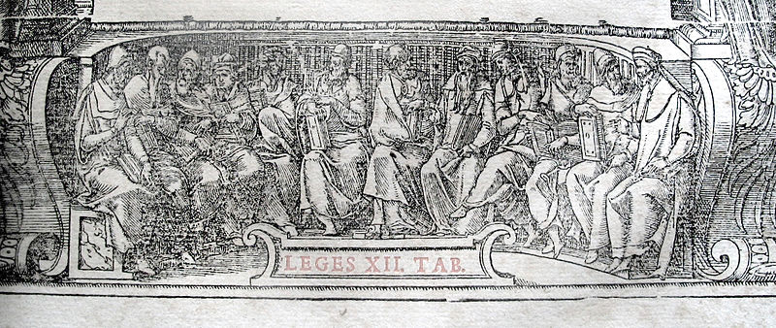
The Twelve Tables (around 450 BCE)
First codification of Roman laws
Contains all existing laws
Makes them officially apply to all Roman citizens .
Notes:
NOTE TO TEACHER
Codification of the law: Putting laws into a Code. For example, today in Quebec, most laws are codified: Criminal Code, Civil Code, etc.
The Twelve Tables are the first code of Roman law. However, other civilizations, such as the Mesopotamians and the Athenians codified their laws a long time before the Romans..
Recovered fragments of the Twelve Tables concern civil law (organization of trials, family law and wills), and criminal law (murder, assault and battery, etc.).
With codification, laws became official. This means that the rules became official, were for the good of society generally and applied to everyone.
Pictorial Source:
Wikicommons. Allégorie de la Loi des Douze Tables, illustration issue d'un livre de droit, 1555.
Sources:
Jean Gaudemet, « ROMAIN DROIT », Encyclopædia Universalis, en ligne: ˂ http://www.universalis-edu.com/encyclopedie/droit-romain/ ˃ (consulté le 24 novembre 2020), p 3-4 (PDF)
Michèle Ducos, « LOI DES DOUZE TABLES », Encyclopædia Universalis, en ligne: ˂ http://www.universalis-edu.com/encyclopedie/loi-des-douze-tables/ ˃ (consulté le 24 novembre 2020), p 1 (PDF)
Jean Gaudemet, « DOUZE TABLES, droit romain », Encyclopædia Universalis, en ligne: ˂ http://www.universalis-edu.com/encyclopedie/douze-tables-droit-romain/ ˃ (consulté le 24 novembre 2020), p 1 (PDF)

Slide 14
The Twelve Tables (around 450 BCE)
Basic legal principles:​
Equality before the law for plebeians and patricians (ordinary citizens and nobility)​. However,
Slaves had no rights.
The principle of equality before the law did not apply to women.
All references to god were deleted. The Romans didn’t believe that laws are handed down to us by gods, but rather are made by mortals.
Notes:
NOTE TO TEACHER
In a way, the Law of the Twelve Tables were an answer to the plebeians and other non-patrician groups increasingly grumbling about an opaque justice system and a "secret" law, known only to legal specialists, who advised patricians almost exclusively. The people also complained of the cruelty of certain punishments. For example, a person who couldn’t repay his debts quickly enough could be enslaved or even killed.
Roman law, like the vast majority of ancient law, has its origins in religion. However, and it is important to stress this major distinction, the Law of the Twelve Tables, like Greek law, does not claim that it originates from divine commandments. Roman law was strongly influenced by Greek law.
Source:
Jean Gaudemet, « ROMAIN DROIT », Encyclopædia Universalis, en ligne: ˂ http://www.universalis-edu.com/encyclopedie/droit-romain/ ˃ (consulté le 24 novembre 2020), p 3 et 7(PDF)

Slide 15
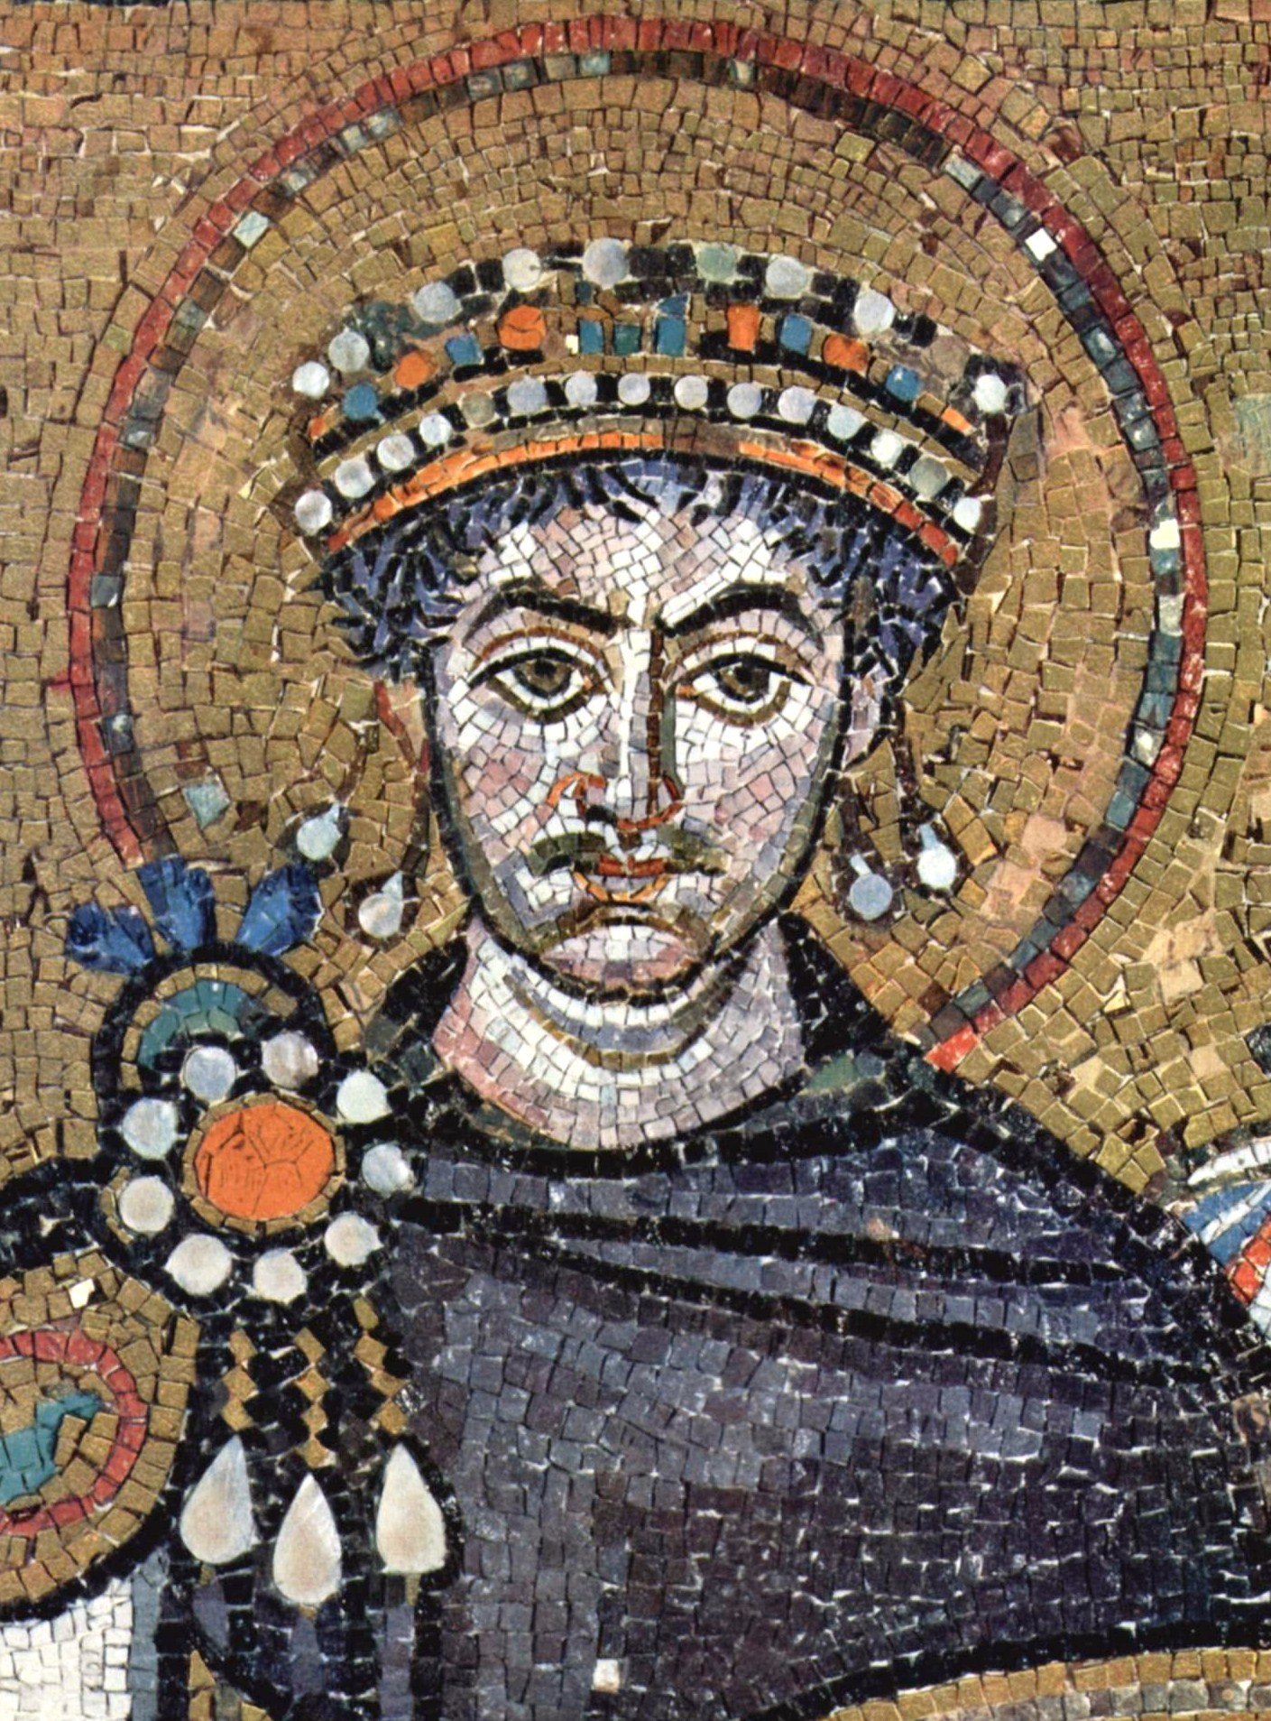
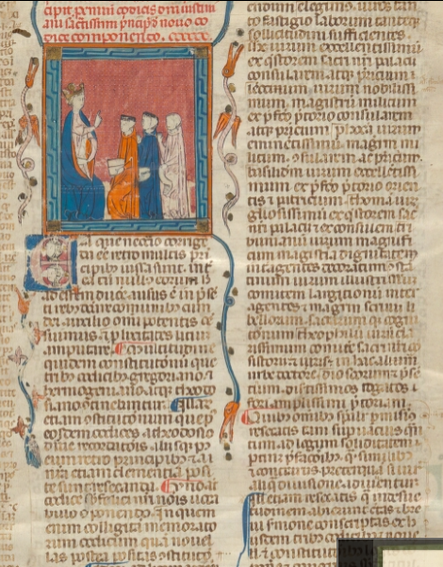
The Justinian Code (529 CE)
Almost 1,000 years had passed since codification of the Twelve Tables.
The Western Roman empire had fallen. The East was trying to establish itself as the guardian of "Roman Civilization".
Emperor Justinian decided to clarify the law by codifying it.
Notes:
NOTE TO TEACHER
The Justinian Code, like the Twelve Tables, is a codification of laws that for the most part already existed. The purpose of the code was to bring together all the sources of law in use at the time: ecclesiastical law, judicial procedure, private law, criminal law, tax law, and administrative law.
Iconographic sources:
Wikicommons. Empereur Justinien 1er. Mosaique de la basilique San Vitale, à Ravenne. Av 547.
Bibliothèque de l'Université de Gand, Extrait du Codex Justiniani I-IX, p.1 (ouvrage datant du 13e siècle)

Slide 16
The Justinian Code (529 CE)
The major principles of the code:
1. "Only the emperor has the power to make laws."​
​
2. "The burden of proving something is on the person who claims it is true, not the person who denies it. " ​
​
3. "It is better to let a crime go unpunished than to convict an innocent person. "
Notes:
NOTE TO TEACHER
Sources:
Jehan de Malafosse, « JUSTINIEN DROIT », Encyclopædia Universalis, en ligne: ˂ http://www.universalis-edu.com/encyclopedie/droit-justinien/ ˃ (consulté 24 novembre 2020), p 1 (PDF)
^{Iconographic sources:}
Wikicommons. Empereur Justinien 1er. Mosaique de la basilique San Vitale, à Ravenne. Av 547.
Bibliothèque de l'Université de Gand, Extrait du Codex Justiniani I-IX, p.1 (ouvrage datant du 13e siècle)

Slide 17
Current Quebec law
Everyone is equal before the law.
The accuser has the burden of proof.
Presumption of innocence.
Only the Head of State can make laws.

Slide 18
Current Québec law
Would you say that the principles of law introduced by the Twelve Tables and the Justinian Code are still present in Quebec society?
Most of these principles are guaranteed by the Canadian Charter of Rights and Freedoms:
Freedom of opinion and expression
Freedom of religion
Right to life, liberty and security of the person
Protection against arbitrary imprisonment
Protection against discrimination
Notes:
NOTE TO TEACHER
Canadian Charter of Rights and Freedoms online: https://laws-lois.justice.gc.ca/eng/const/page-15.html

Slide 19
Everyone is equal before the law
Introduced by the Justinian Code. The plebeians and patricians (ordinary people nobility) are equal before the law. The law applies to all free men The consequences of breaking the law are the same for everyone. | Guaranteed by the Canadian Charter of Rights and Freedoms. All citizens are equal before the law. " Every individual is equal before and under the law and has the right to the equal protection and equal benefit of the law without discrimination (…)." Section 15 (1)
Are there things that the Prime Minister of Canada has the right to do, but we don’t?​
Would you say that being rich is an advantage if you’re accused of a crime? Why?
Notes:
NOTE TO TEACHER
Canadian Charter of Rights and Freedom online: https://laws-lois.justice.gc.ca/fra/const/page-15.html
Sources:
Titre III des Lois des sénatus-consultes et des coutumes paragraphe 8, Digeste Livre I (p 18 PDF) ˂ http://www.histoiredudroit.fr/Documents/Corpus/Digeste%20(Livre%201).pdf ˃
Charte canadienne des droits et libertés, Loi de 1982 sur le Canada, Annexe B, 1982 (R-U), ch11, art 15 (1)

Slide 20
The accuser/plaintiff has the burden of proof
Introduced by the Justinian Code. "The burden of proving something is on the person who claims it is true, not the person who denies it. " | Civil Code of Québec, article 2803. A person seeking to assert a right shall prove the facts on which his claim is based. A person who claims that a right is null, has been modified or is extinguished shall prove the facts on which he bases his claim
Notes:
NOTE TO TEACHER
Burden of Proof: "The obligation of a party in a trial to convince the court of the merits of his or her case beyond a reasonable doubt in criminal trials) or on the balance of probabilities (in civil law trials)”.
For further explanation of the difference between the burden of proof in criminal trial and the burden of proof in civil trials: https://www.youtube.com/watch?v=Lz0JwSkrt-w
Sources:
Titre IV de l'assignation en justice, Digeste livre II (p 8 PDF) ˂ http://www.histoiredudroit.fr/Documents/Corpus/Digeste%20(Livre%202).pdf ˃
Code civil du Québec, RLRQ, c C-1991, art 2803

Slide 21
Presumption of innocence
Introduced by the Justinian Code "It is better to let a crime go unpunished than to convict an innocent man." | Right guaranteed by the Canadian Charter of Rights and Freedoms. "Everyone has the right not to be arbitrarily detained or imprisoned." Section 9 "Any person charged with an offence has the right to be presumed innocent until proven guilty [...] in a fair and public hearing […]. " Section 11 (d)
Notes:
NOTE TO TEACHER
Sources:
Rescrit de l’Empereur Trajan exposé dans le Digeste, D.48, 19, 5. (https://www.cairn.info/revue-archives-de-politique-criminelle-2007-1-page-41.htm note de bas de page 15 )
Charte canadienne des droits et libertés, Loi de 1982 sur le Canada, Annexe B, 1982 (R-U), ch11, art 9, 11 b)

Slide 22
Only the Head of State can make laws
Introduced by the Justinian Code "Only the Emperor has the power to make laws." | Constitution Act "It shall be lawful for the Queen, by and with the Advice and Consent of the Senate and House of Commons, to make Laws for the Peace, Order, and good Government of Canada." Section 91
Notes:
King Charles III is Canada's Head of State.
Here are some interesting resources if you would like to give your students more information on the process of passing legislation:
Par ici la démocratie: (in French only) http://www.paricilademocratie.com/approfondir/parlementarisme-et-elections/685-le-processus-d-adoption-d-une-loi
Introduction to the workings of the Parliament of Canada: https://bdp.parl.ca/About/Parliament/Education/ourcountryourparliament/html_booklet/process-passing-bill-e.html
Sources:
Titre IV des ordonnances des princes, Digeste livre I (p 22 PDF) ˂ http://www.histoiredudroit.fr/Documents/Corpus/Digeste%20(Livre%201).pdf ˃
Loi constitutionnelle de 1867, 30 & 31 Vict, c3, art 91

Slide 23
Instagram/educaloi_en
YouTube/educaloi
Facebook/educaloi
educaloi.qc.ca/en

